Slide 1

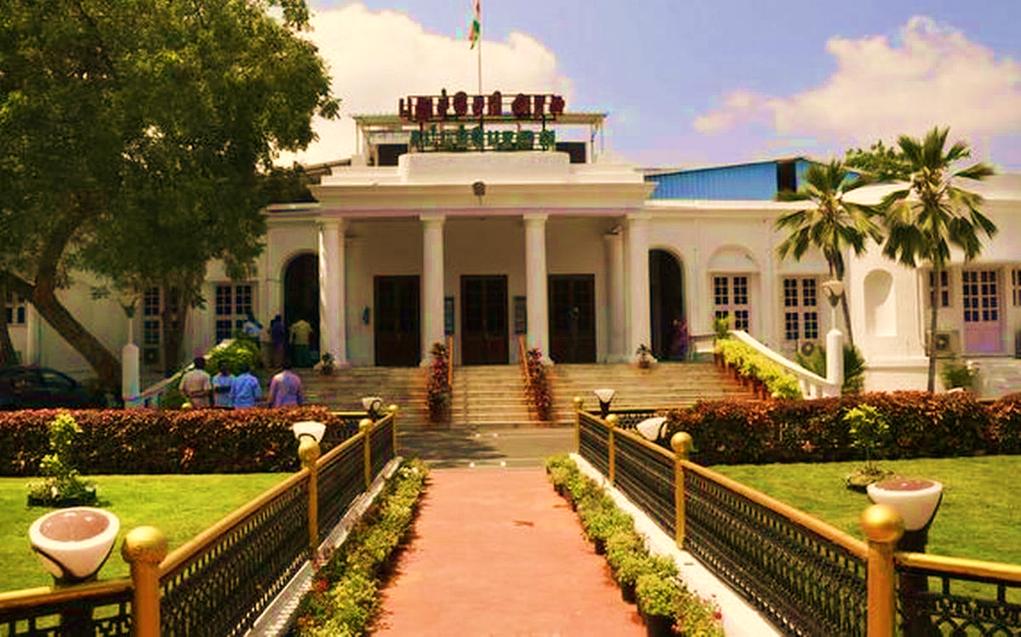
GENERAL ELECTIONS TO PUDUCHERRY LEGISLATIVE ASSEMBLY, 2026 OFFICE OF THE RETURNING OFFICER X WARMLY WELCOMES YOU ALL FOR THIS POLLING PERSONNEL TRAINING SESSION

Slide 2
CONGRATULATIONS
ON TAKING UP THE ASSIGNMENT IN CONDUCT OF ELECTION TO THE GENERAL PUDUCHERRY LEGISLATIVE ASSEMBLY, 2026

Slide 3
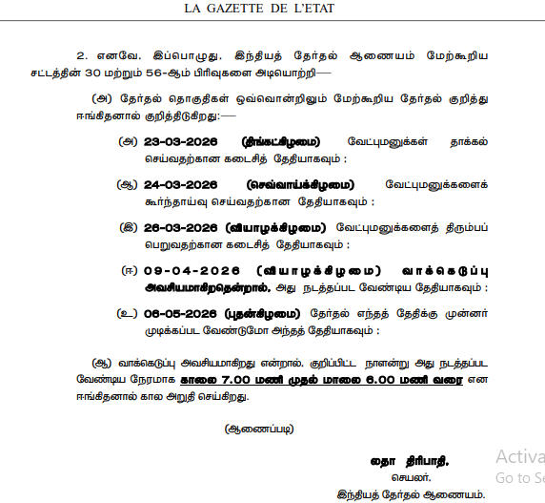
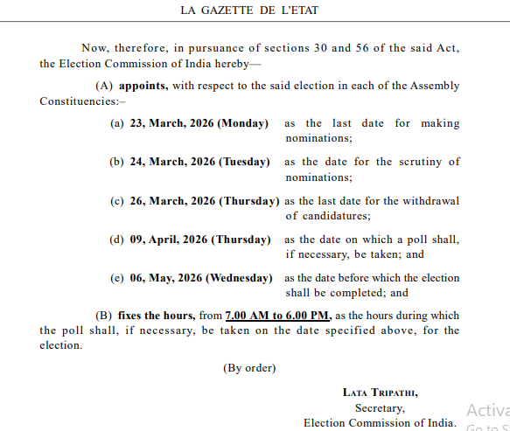
GENERAL ELECTION TO THE LEGISLATIVE ASSEMBLY OF
U .T . OF PUDUCHERRY – ECI NOTIFICATION.

Slide 4
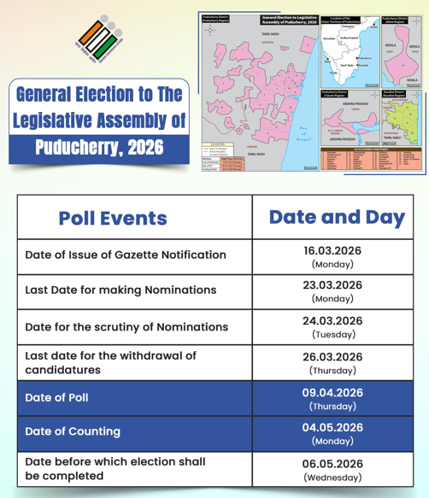
GENERAL ELECTION TO THE LEGISLATIVE ASSEMBLY OF
U .T . OF PUDUCHERRY – TIMELINE

Slide 5
Appointment of Polling Personnel
Under Sec 26 of RPA 1951, DEO appoints.
Deemed Deputation to ECI under sec 28A of RPA 1951
From date of Notification to Declaration of Result.

Slide 6
Tasks Completed Before Pre-Poll Day
Polling Booths - AMF and EMF ensured, Queue sheds, temporary ramps, and 100-metre and 200-metre demarcation around the Polling Stations have been properly marked.
EVM – All EVMs, including reserve machines, have been commissioned and secured in the Strong Room.
Polling personnel – Presiding Officers and Polling Officers have undergone three rounds of training.

Slide 7
Tasks Completed Before Pre-Poll Day
Sufficient copies of the marked electoral roll, duly authenticated, will be kept ready.
Required stationery, statutory forms, covers, signage materials, and medical kits kept ready at Distribution Centre.
Polling personnel informed about reporting time and venue.

Slide 8
PRE - POLL DAY

Slide 9
ON PRE-POLL DAY
PO-1, PO-2, and PO-3 to receive Polling Duty appointment orders from office of the concern Returning Officers before 10:30 AM
The Polling Officers should reach their respective Polling Stations before 2:00 PM after taking their lunch.

Slide 10
ON PRE-POLL DAY
Presiding Officers shall report before concern Returning Officers at the Distribution Centre at 10:00 A.M.
Sector Officers will collect EVMs and polling materials from the Returning Officer under proper acknowledgement.
Materials shall be loaded only into the sector-designated vehicles.
Presiding Officers of the respective sector will be taken to concern polling booth in same vehicle.

Slide 11
ON PRE-POLL DAY
Sector Officer shall hand over EVMs and Polling Materials to the Presiding Officer at the respective Polling Station.
Handover shall be completed under proper acknowledgement and documentation
Verification of materials should be carried out only at the Polling Station.

Slide 12
POLLING MATERIALS
EVM, Electoral Rolls and others
Forms and Formats Statutory ,Non Statutory Booklets
Candidate Information booklet
Envelopes 1 to 6
Seals, Tags, Marks
Hand books and Instructions
Stationery Items

Slide 13
PRE-POLL DAY
PRE POLL DAY ARRANGEMENT – AT THE BOOTH
Display notice of polling area.
Display list of contesting candidates in Form 7A.
Voter Facilitation Posters on outside wall near entrance.
Plan seating for polling officials and polling agents.
Polling Agents to be seated behind Polling Officers.

Slide 14
PRE-POLL DAY –
PRE POLL DAY ARRANGEMENT – AT THE BOOTH
Polling agents to see the face of electors and watch the entire operation.
Polling Officers and Agents should be seated in such a way that secrecy of vote is maintained (Section 128) .
Affix sign board – ‘Way to polling booth’, ‘Polling Officers’, ‘Polling Agents’ etc. at appropriate places.
Voting compartment – Sufficient lighting and maintain secrecy of voting. NO DIRECT lighting on VVPAT.

Slide 15
PRE-POLL DAY –
PRE POLL DAY ARRANGEMENT – AT THE BOOTH
Polling officials should have a clear idea of the arrangements for setting up of the Polling Station in a proper way especially to secure secrecy of voting, regulation of voters’ queue, protection of poll proceedings free from outside interference, etc
Under no circumstances, the Ballot Units, or the Control Units or VVPATs should be placed on the floor. They must be kept on a table;

Slide 16
PRE-POLL DAY –
PRE POLL DAY ARRANGEMENT – AT THE BOOTH
The polling personnel to segregate Forms, Covers, Stationeries and other polling materials.
Get acquainted about various forms, covers and other stationaries.
The Forms, Covers may be filled wherever possible on the pre-poll day itself.
Never accept the hospitality of local people.
Discuss with your team on their duties and role.

Slide 17
PRE-POLL DAY –
PRE POLL DAY ARRANGEMENT – AT THE BOOTH
Polling Personnel are fully in-charge of all materials.
Polling materials not to be left in the custody of police guards on duty.
Polling Officers should be conversant with entries in marked copy of electoral roll.

Slide 18
PRE-POLL DAY –
PRE POLL DAY ARRANGEMENT – AT THE BOOTH
MARKED COPY OF ELECTORAL ROLL
Four marked copies of electoral roll will be supplied to each Polling Station.
For reference of Presiding Officer.
For 1st Polling Officer for identification of voters.
For circulation among Polling agents /Exhibition at Polling Station.
For reserve.
Ensure that all the copies of electoral roll are complete and identical in every respect..

Slide 19
PRE-POLL DAY –
PRE POLL DAY ARRANGEMENT – AT THE BOOTH
MARKED COPY OF ELECTORAL ROLL
Ensure :
The marked copy pertains to your polling station.
It is complete in all respects along with supplements.
All the pages have been serially numbered from Sl.No.1.
The printed serial numbers of the voters are not corrected with ink and no new numbers are substituted for them.

Slide 20
PRE-POLL DAY –
PRE POLL DAY ARRANGEMENT – AT THE BOOTH
MARKED COPY OF ELECTORAL ROLL
Ensure :
5. It does not contain any remarks other than PB (Post Ballot), and other authorized markings.
6. The electoral roll is signed by the Assistant Electoral Registration Officer and one more official.
7. A certificate signed in ink by the Returning Officer-cum-Electoral Registration Officer is attached on the top of the copy of the electoral roll to be used as marked copy.

Slide 21
PRE-POLL DAY –
PRE POLL DAY ARRANGEMENT – AT THE BOOTH
MARKED COPY OF ELECTORAL ROLL SYMBOLS
Marking “E” indicates “Expired”.
“S” indicates “Shifted”.
“R” indicates “Duplicate Voter”.
“#” indicates “Entry corrected in the supplement”.
“Q” indicates “Disqualified”.
“M” Missing after natural disaster/NBW cases.
Along with marked copy of electoral roll, the list of absentee and shifted voters, if any, will be given.
The marked copy will have a list of “DELETED VOTERS”. They are not entitled to vote in the election.

Slide 22
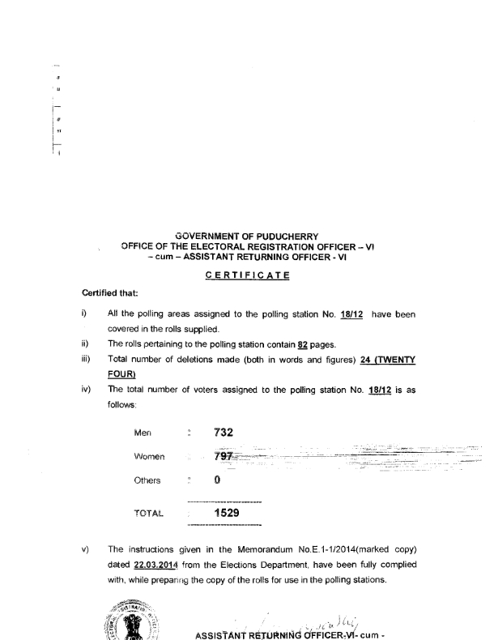
PRE-POLL DAY –
PRE POLL DAY ARRANGEMENT – AT THE BOOTH
MARKED COPY OF ELECTORAL ROLL CERTIFICATE

Slide 23
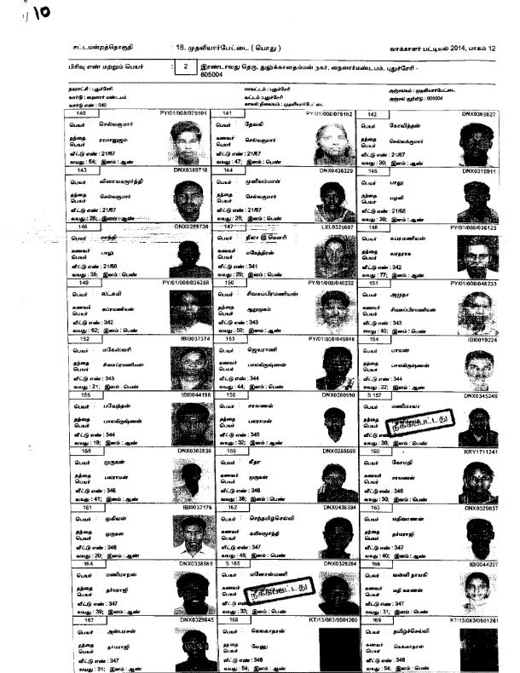
PRE-POLL DAY –
PRE POLL DAY ARRANGEMENT – AT THE BOOTH
MARKED COPY OF ELECTORAL ROLL SAMPLE

Slide 24
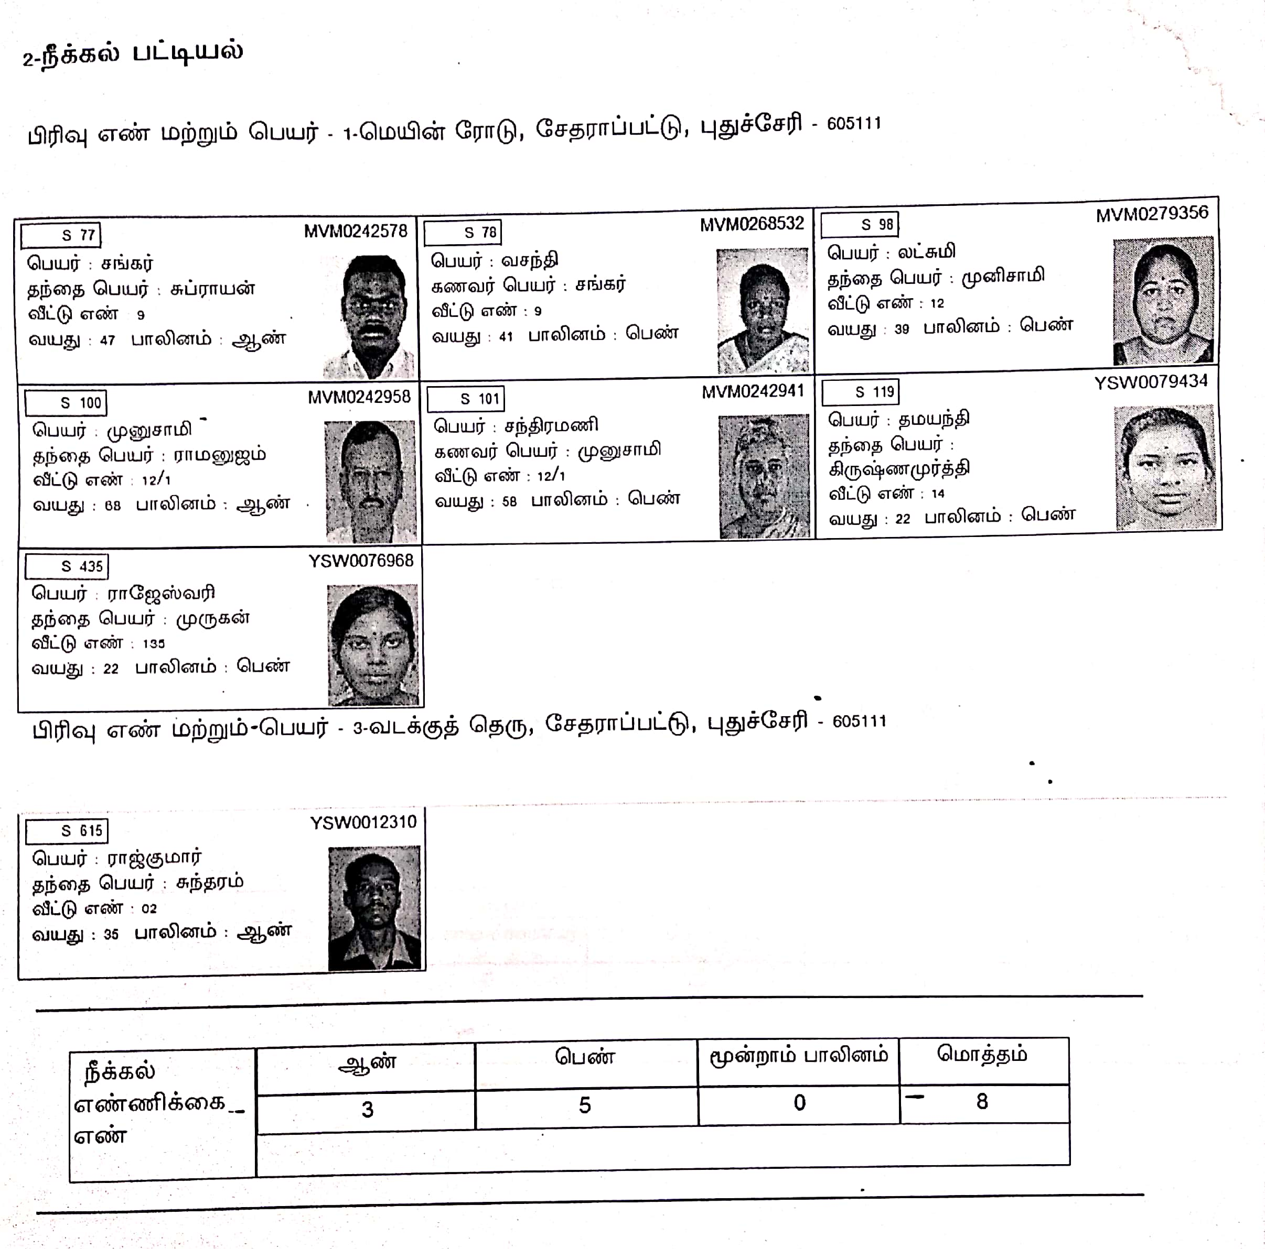
PRE-POLL DAY –
PRE POLL DAY ARRANGEMENT – AT THE BOOTH
MARKED COPY OF ELECTORAL ROLL – SUPPLEMENT DELETED LIST

Slide 25
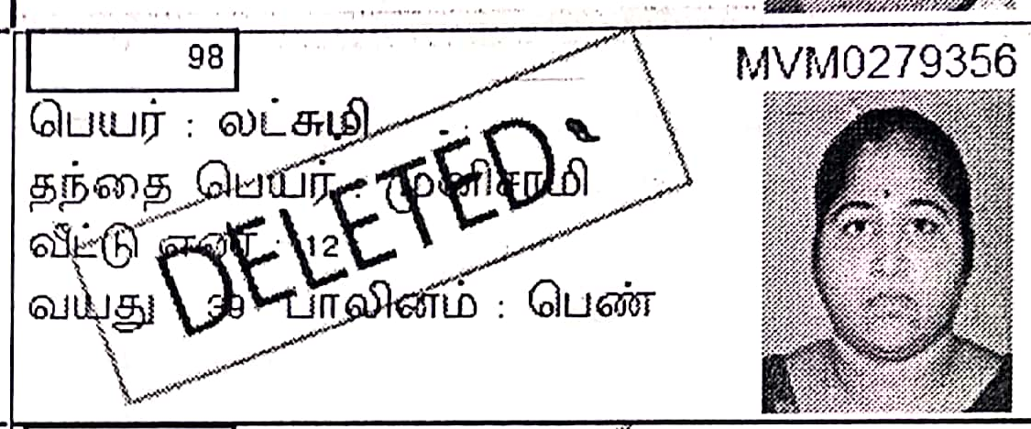
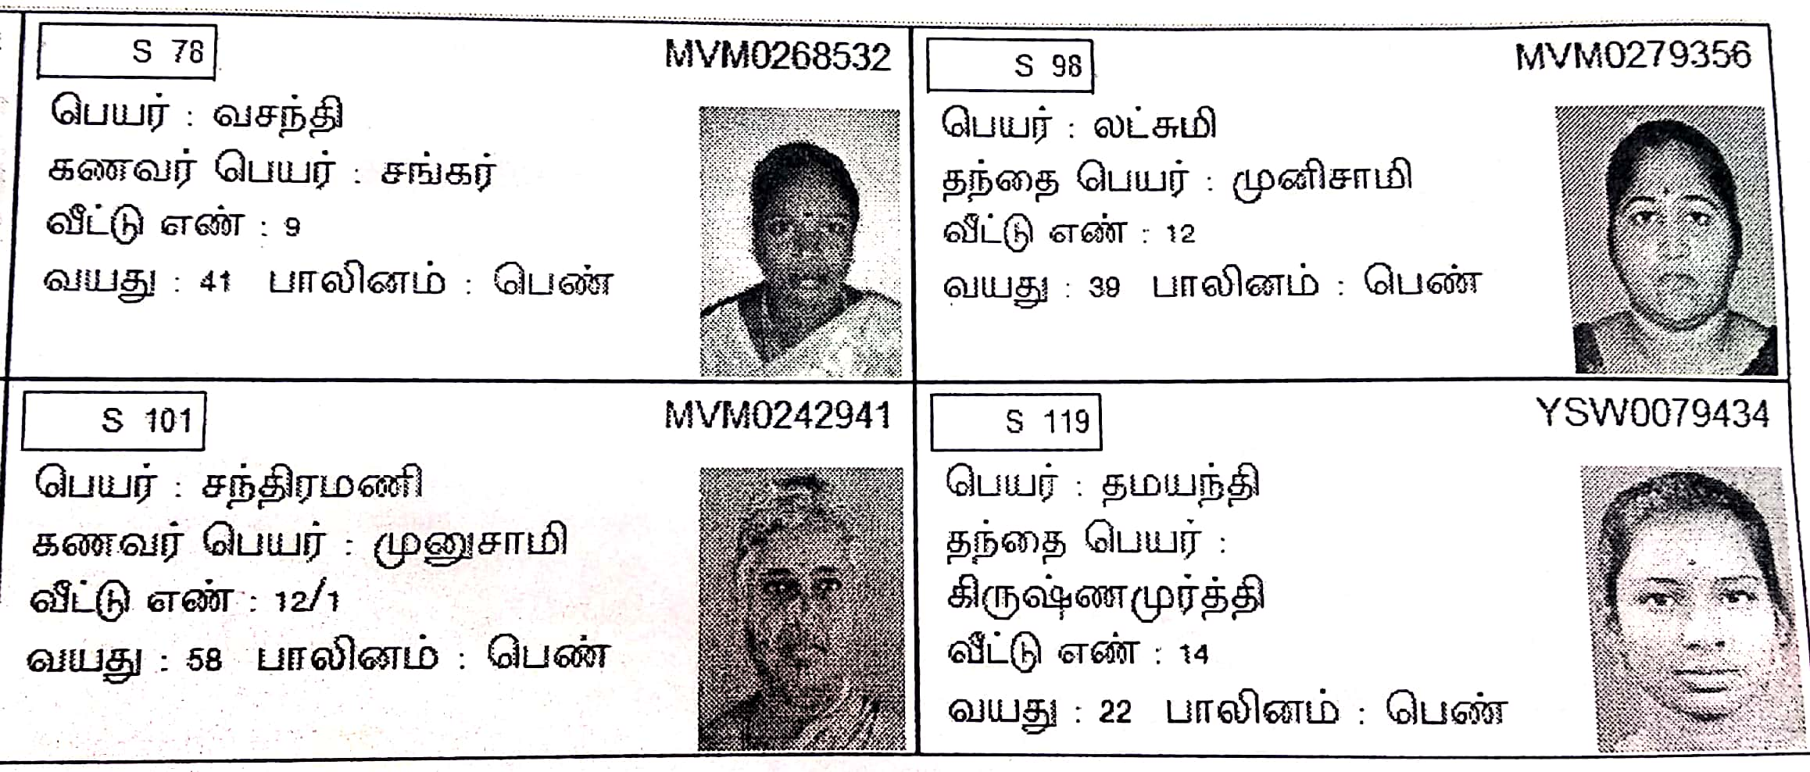
PRE-POLL DAY –
PRE POLL DAY ARRANGEMENT – AT THE BOOTH
MARKED COPY OF ELECTORAL ROLL
MAIN ROLL
SUBLIMENT DELETED LIST
S - SHIFTED

Slide 26
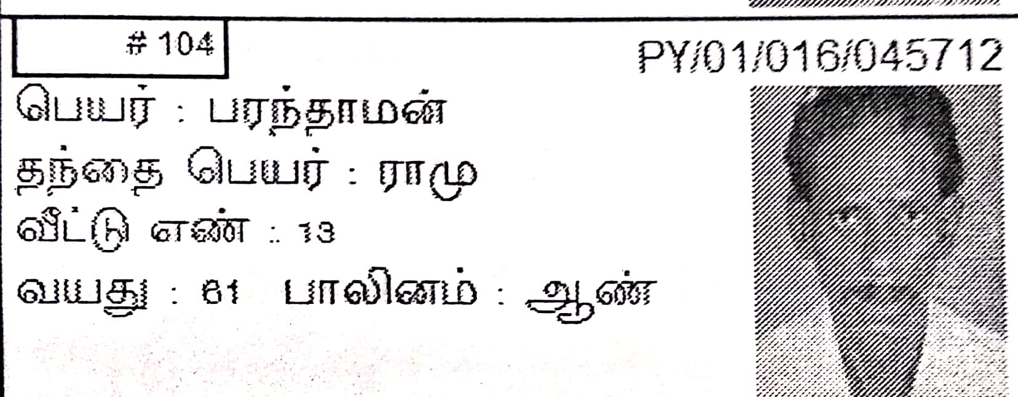
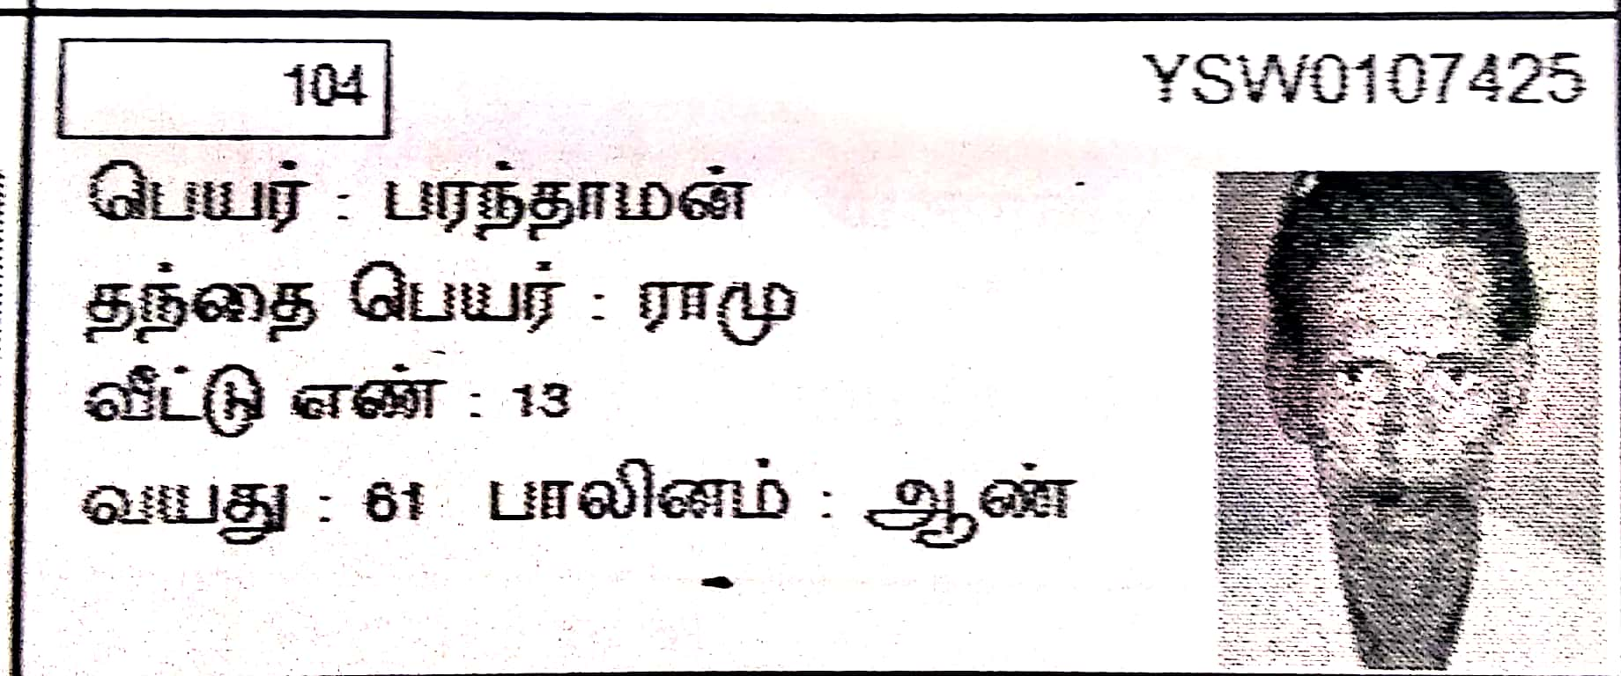
PRE-POLL DAY –
PRE POLL DAY ARRANGEMENT – AT THE BOOTH
MARKED COPY OF ELECTORAL ROLL
MAIN ROLL
CORRECTED LIST

Slide 27
poll day 09/04/2026
MOCK POLL AND SEALING OF EVM & VVPAT

Slide 28
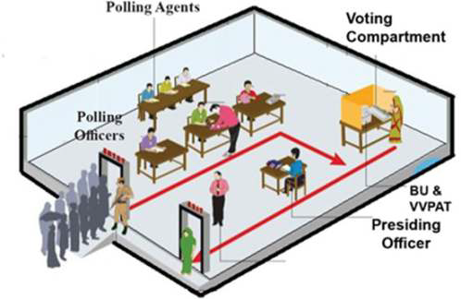
Model layout

Slide 29
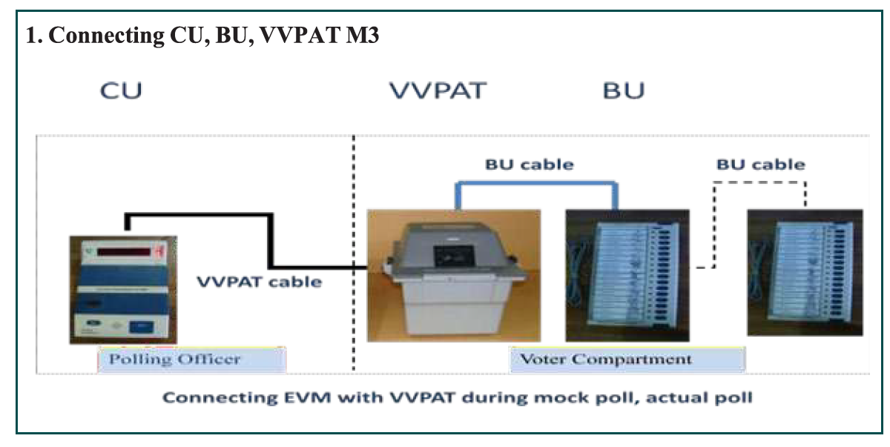
Connecting BU,CU, VVPAT

Slide 30
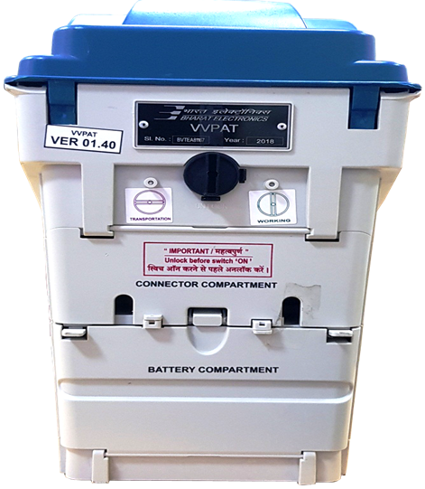
VVPAT SETTING
Transportation
Working
Easy remembering technique –
HT – Horizontal – Transportation mode
VW – Vertical – Working mode

Slide 31


MOCK POLL
MOCK POLL – Minimum 50 VOTES
IF NO AGENTS THEN WAIT UPTO
5 : 30 A.M
5 : 45 A.M
MINIMUM 2 POLLING AGENTS

Slide 32
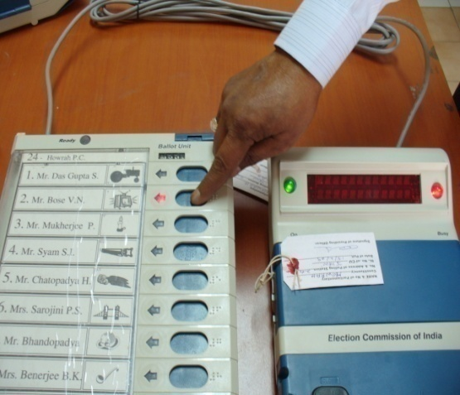
MOCK POLL
Order to be followed
Seal
Switch off
7
Clear
6
Result
5
Close
4
Ballot
3
Ensure votes polled for all candidates
Ensure 0
2
Total

Slide 33
MOCK POLL at 90 minutes before actual start of Poll

Slide 34
MOCK POLL

Slide 35
MOCK POLL

Slide 36
MOCK POLL

Slide 37
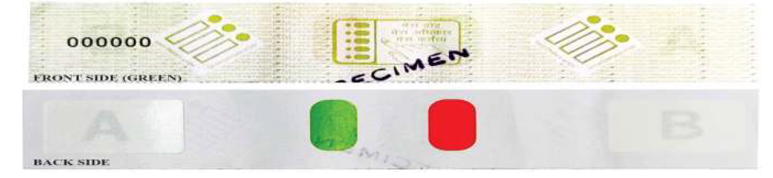
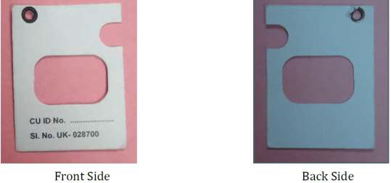
Sealing the CU and VVPAT
Materials to be ready: Address Tags, Green paper Seals, Special Tag, Thread, Sealing Wax, Candle, Box with matches (NO STRIP SEAL LIKE LOK SABHA ELECTIONS, 2024)

Slide 38
Sealing the Control Unit

Slide 39
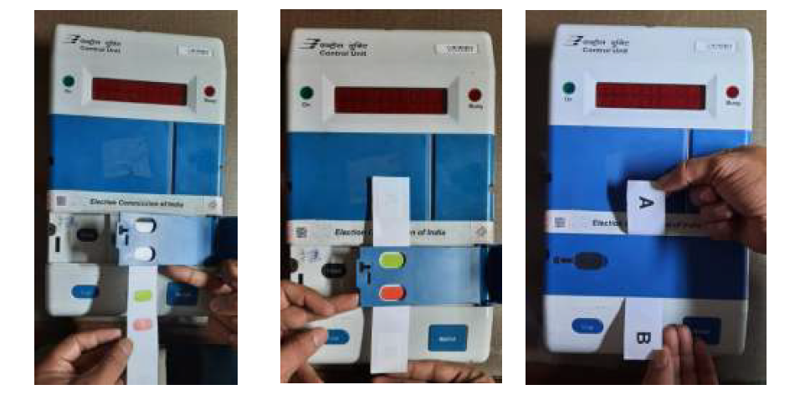
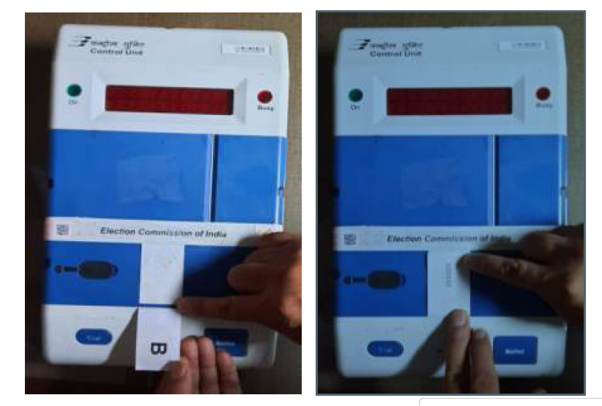
Step by Step photograph of CU sealing

Slide 40
VVPAT Sealing

Slide 41
VVPAT Sealing

Slide 42
Photograph of VVPAT sealing

Slide 43
At the Start of Poll

Slide 44
At the Start of Poll

Slide 45
EVM replacement protocol
EVM/VVPAT Replacement Protocol*
Un-polled
Polled
Prior to Mock Poll
During Mock Poll
After Poll Commencement
Defect In either CU/BU/VVPAT
Defect in either CU/BU/VVPAT
Defect in either BU or CU.
Defect in VVPAT Only
Replace the defective Unit Only
Replace the defective Unit only.
Replace all the 3 Units
Replace the VVPAT Only.
Mock Poll 1 Vote
Each Candidate
No Mock-Poll
* As on today

Slide 46
Common Errors noticed in EVM
For errors in BU/CU/VVPAT - Msg. will be displayed in CU only.
In CU, after pressing Ballot Button , it is showing -
“PRESSED ERROR BU” – It means any Button in the BU is Jammed. It requires cleaning/ removal of the same
“BU NOT CONNECTED” – Connection with BU is not proper
“BU NOT RESPONDING”- Either connection between Units is not proper or there may be mistake in Thumb wheel Positioning of BU.
“VVPAT NOT RESPONDING”- Paper Roll Knob of VVPAT not kept in Vertical position / VVPAT Battery is low.
“INVALID” – CU Button is pressed out of sequence ( C-R-C)
“CLOCK ERROR” – Malfunctioning of Real Time Clock
“ ELECTION EXCEEDED ” – When Poll Date is over

Slide 47
Filling of MOCK – POLL CERTIFICATE

Slide 48
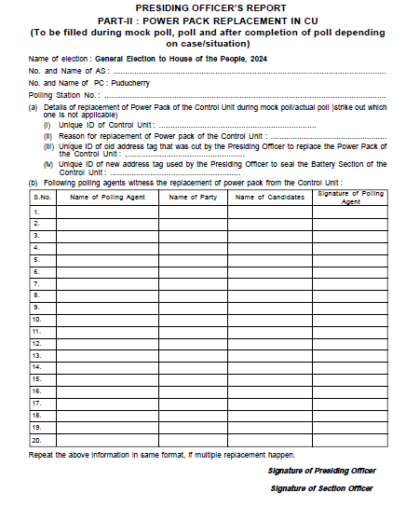

Slide 49
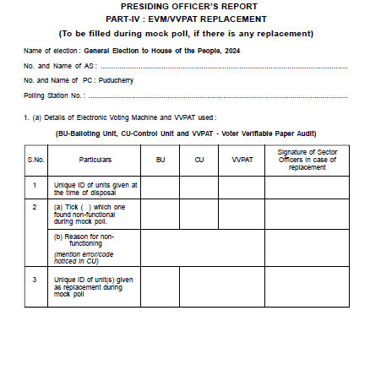
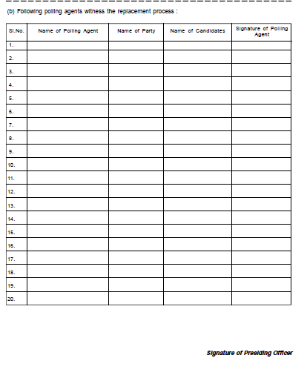

Slide 50
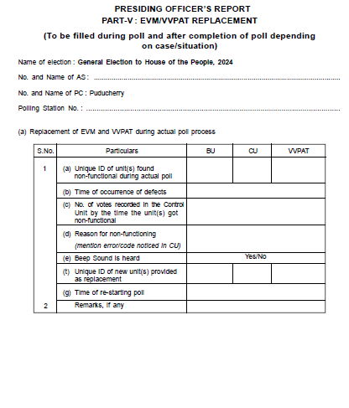
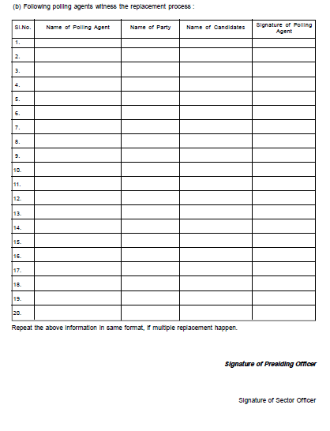

Slide 51
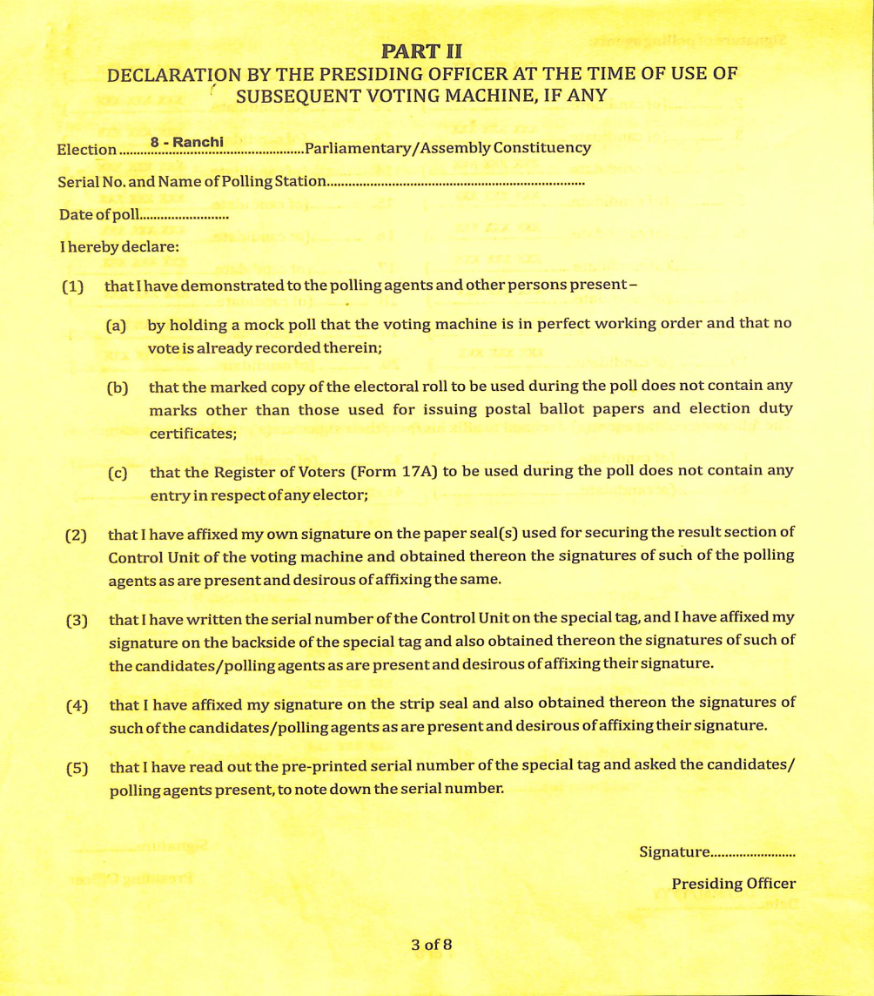
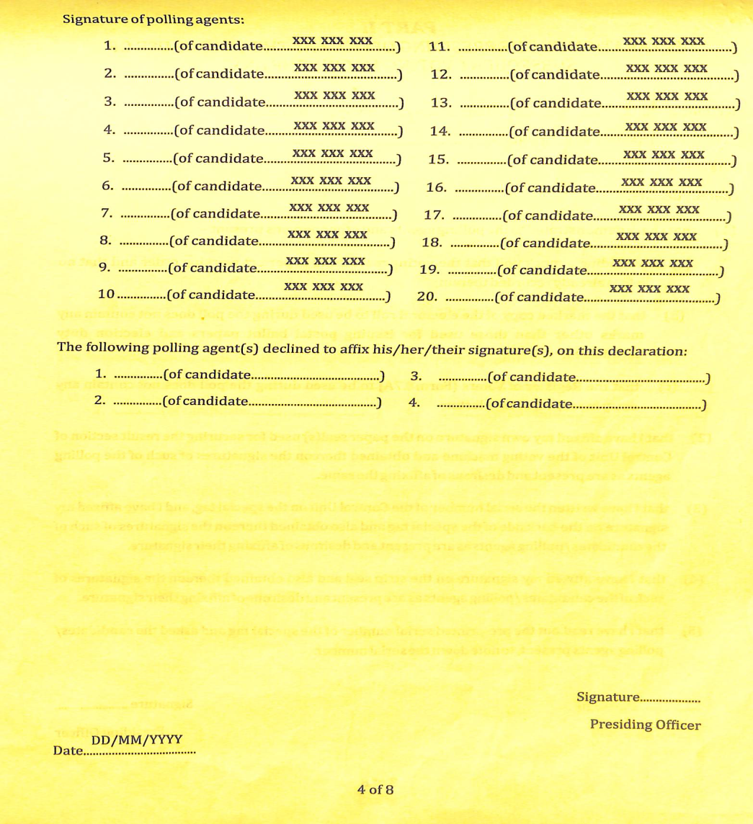

Slide 52
ACTUAL START OF POLL
Ensure that all the members of the Polling Party are in position well before the commencement of the poll and all the material and records are kept handy and ready to commence poll at 7.00 AM.
Before commencing the poll, the candidates, or their agents, who are present at the Polling Station and the Polling Officers, should be briefed about the maintenance of secrecy of vote. The provisions of Section 128 of the Representation of the People Act, 1951 should be read out and brought to their notice.
Read out the declaration aloud to the hearing of all persons present in Polling Station and sign on the declaration and obtain signature of such Polling Agents as are present and willing to affix the same.
COMMENCE THE ACTUAL POLL AT SHARP 7.00 AM.

Slide 53
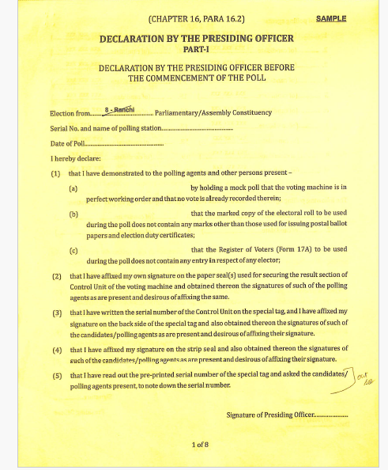
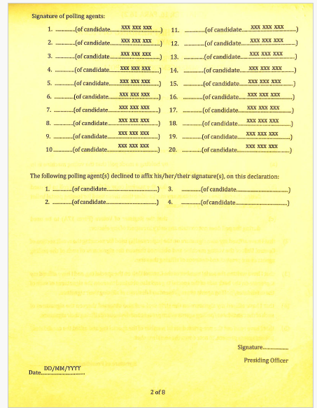
DECLARATION BY THE PRESIDING OFFICER DURING COMMENCEMENT OF POLL

Slide 54
DUTIES AND RESPONSIBILITIES OF POLLING OFFICERS

Slide 55
DUTIES AND RESPONSIBILITIES OF 1ST POLLING OFFICERS

Slide 56
POLL DAY
First Polling Officer
Get in charge of marked copy of electoral roll.
Before the first voter votes, PrO and I-PO should check 17 A and CU. Record in ink – Total in CU checked and found to be ZERO
As the elector enters the polling booth – Verify EPIC or other identity proof as per ECI instructions and find his/her name in the electoral roll and ensure the voter identity.
After satisfied with the identity of the elector, read aloud the voter name with serial number in the electoral roll

Slide 57
POLL DAY
First Polling Officer
i. When voter is allowed to vote, draw -
diagonal line in RED on the entry in the MC-Male
diagonal line in RED & Round off the Sl No- Female
diagonal line in RED & STAR near the Sl No- Third Gender
ii. Fill up the statistical details – Male, Female and others separately in the sheet provided for getting Bi-hourly report;

Slide 58
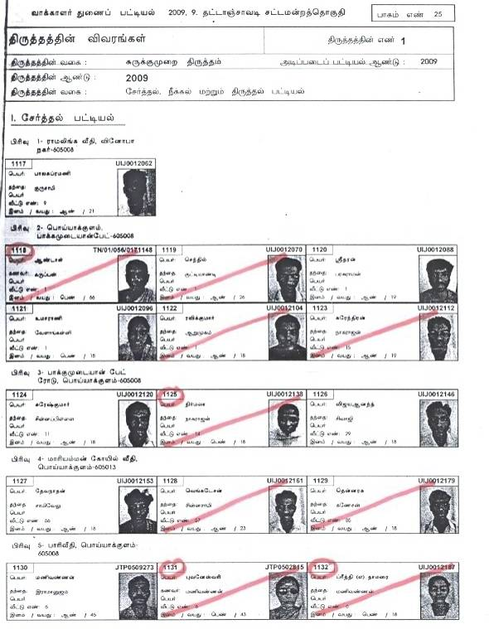
POLL DAY
First Polling Officer

Slide 59
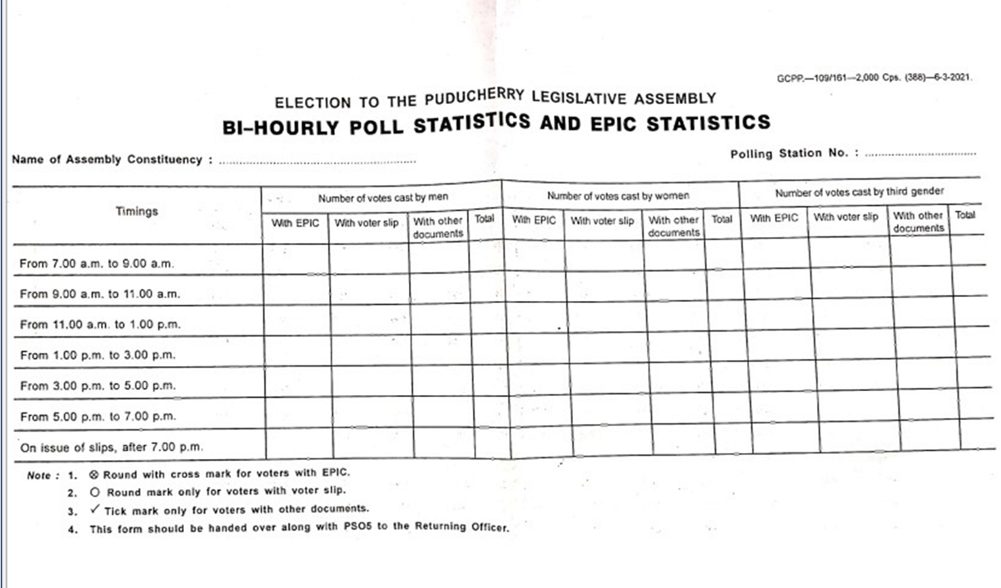
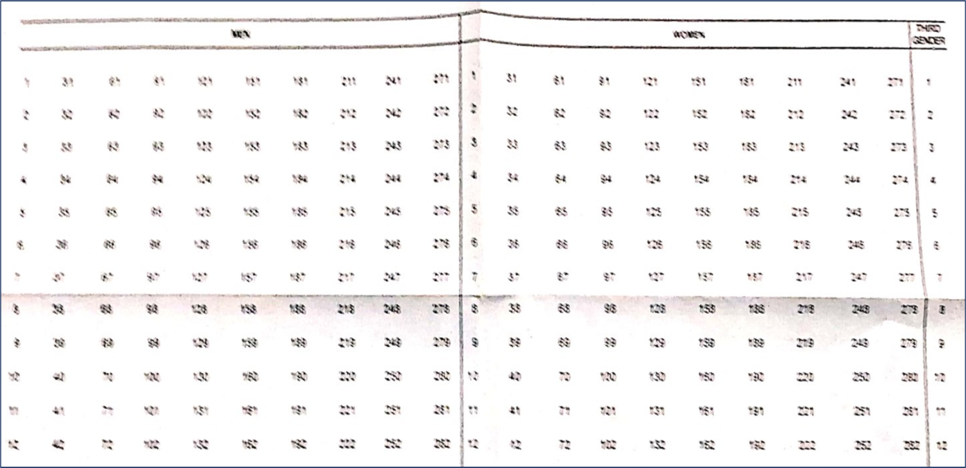
POLL DAY
First Polling Officer - BI HOURLY REPORT & EPIC STATISTICS
The first polling officer will be in charge of bi-hourly and poll statistics
After identifying the voter the PO shall mark under the relevant category namely men, women and third gender
If voter comes with EPIC as identity document, round the appropriate number with cross mark.
For any other document make a tick mark
While giving bi-hourly poll statistics the PO has to provide data gender wise with EPIC and other documents

Slide 60
POLL DAY
First Polling Officer
Allow 1 male and 2 female alternatively and give importance to senior citizen and physically disabled persons.
Presiding officer and Polling officer-I shall control the entry of electors and ensure that only 2 to 3 electors are present inside the polling booth at any point of time.
If the name of the elector is found to be in ASD list then he/she may be directed to the Presiding Officer.

Slide 61
POLL DAY
First Polling Officer
List of ASD [Absentee, Shifted and Dead] voters prepared polling station wise and provided to the Presiding Officers.
If any voter from the ASD list comes to cast vote, he should produce his EPIC or any other document prescribed by the Commission for identification.
The Presiding Officer shall verify the Identity of ASD voter.

Slide 62
POLL DAY
First Polling Officer
List of ASD [Absentee, Shifted and Dead] voters prepared polling station wise and provided to the Presiding Officers.
If any voter from the ASD list comes to cast vote, he should produce his EPIC or any other document prescribed by the Commission for identification.
The Presiding Officer shall verify the Identity of ASD voter.

Slide 63
POLL DAY
First Polling Officer
Such ASD voters shall be allowed to vote after obtaining a declaration in the prescribed format
Such voter’s thumb impression should also be obtained, in addition to his signature in Form 17A.
Even if the elector is literate, his thumb impression should be obtained.
Wherever possible, such elector may be photographed and record kept.
Maintain a record of such voters and to be submitted at the end of the poll.

Slide 64
POLL DAY
First Polling Officer
The ASD voters should be flagged in the Marked copy of the Electoral Roll based on the ASD list provided along with the Polling Materials.
Role of First Polling Officer is very crucial in maintaining the order of the booth by regulation of entry of voters into the booth

Slide 65
POLL DAY
First Polling Officer
VERIFICATION OF ELECTOR’S IDENTITY
If EPIC could not be produced, alternative document permitted by the ECI may be allowed.
In case of any doubt over identity, Polling Officer to direct the elector to Presiding Officer.
Presiding Officer to probe the identity of voter.
Impersonator to be handed over to police with written complaint.

Slide 66
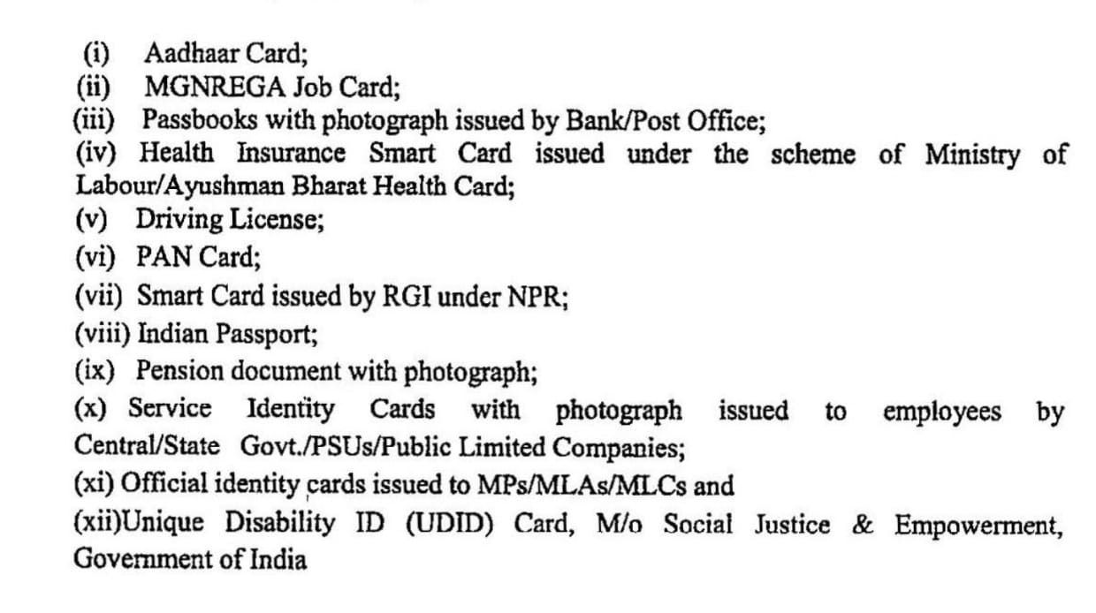
POLL DAY
First Polling Officer
ALTERNATE DOCUMENTS FOR EPIC AS PER ECI ORDER

Slide 67
POLL DAY
First Polling Officer
VERIFICATION OF ELECTOR’S IDENTITY
Minor discrepancies in elector’s name, sex, age or address may be ignored.
Discrepancy in the Sl. No. of EPIC as mentioned in electoral roll shall be ignored.
EPIC of another Assembly Constituency shall be permitted if the name of elector finds place in your electoral roll.

Slide 68
POLL DAY
First Polling Officer
A Man and TWO women to be admitted alternately.
Don’t form more than one queue for men and women voters.
Don’t give any special treatment to any VIP or celebrity coming to cast vote.
Don’t allow any overcrowding especially of photographers / videographers at such time.

Slide 69
DUTIES AND RESPONSIBILITIES OF 2ND POLLING OFFICERS

Slide 70
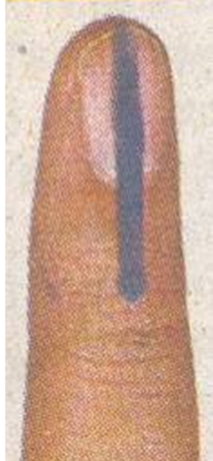
POLL DAY
Second Polling Officer
Get in charge of the register or voters form-17A.
Take custody of indelible ink.
Put mark on the forefinger of the voter in left hand from top of the nail down to first joint below nail

Slide 71
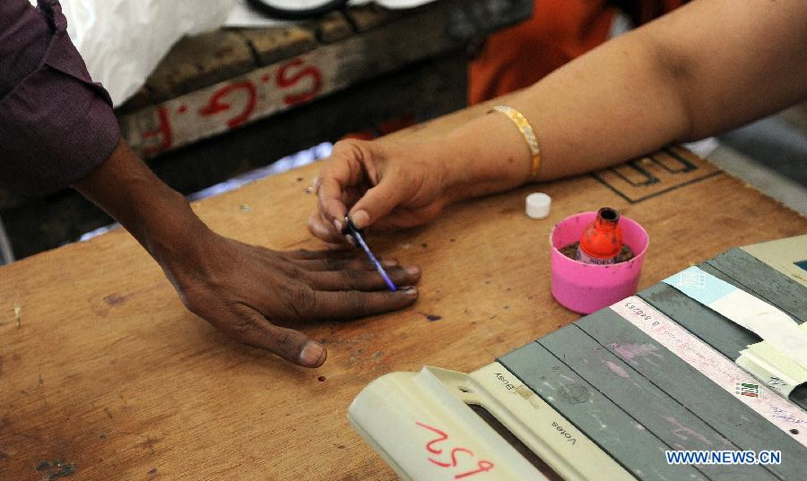
POLL DAY
Second Polling Officer
APPLICATION OF INDELIBLE INK

Slide 72
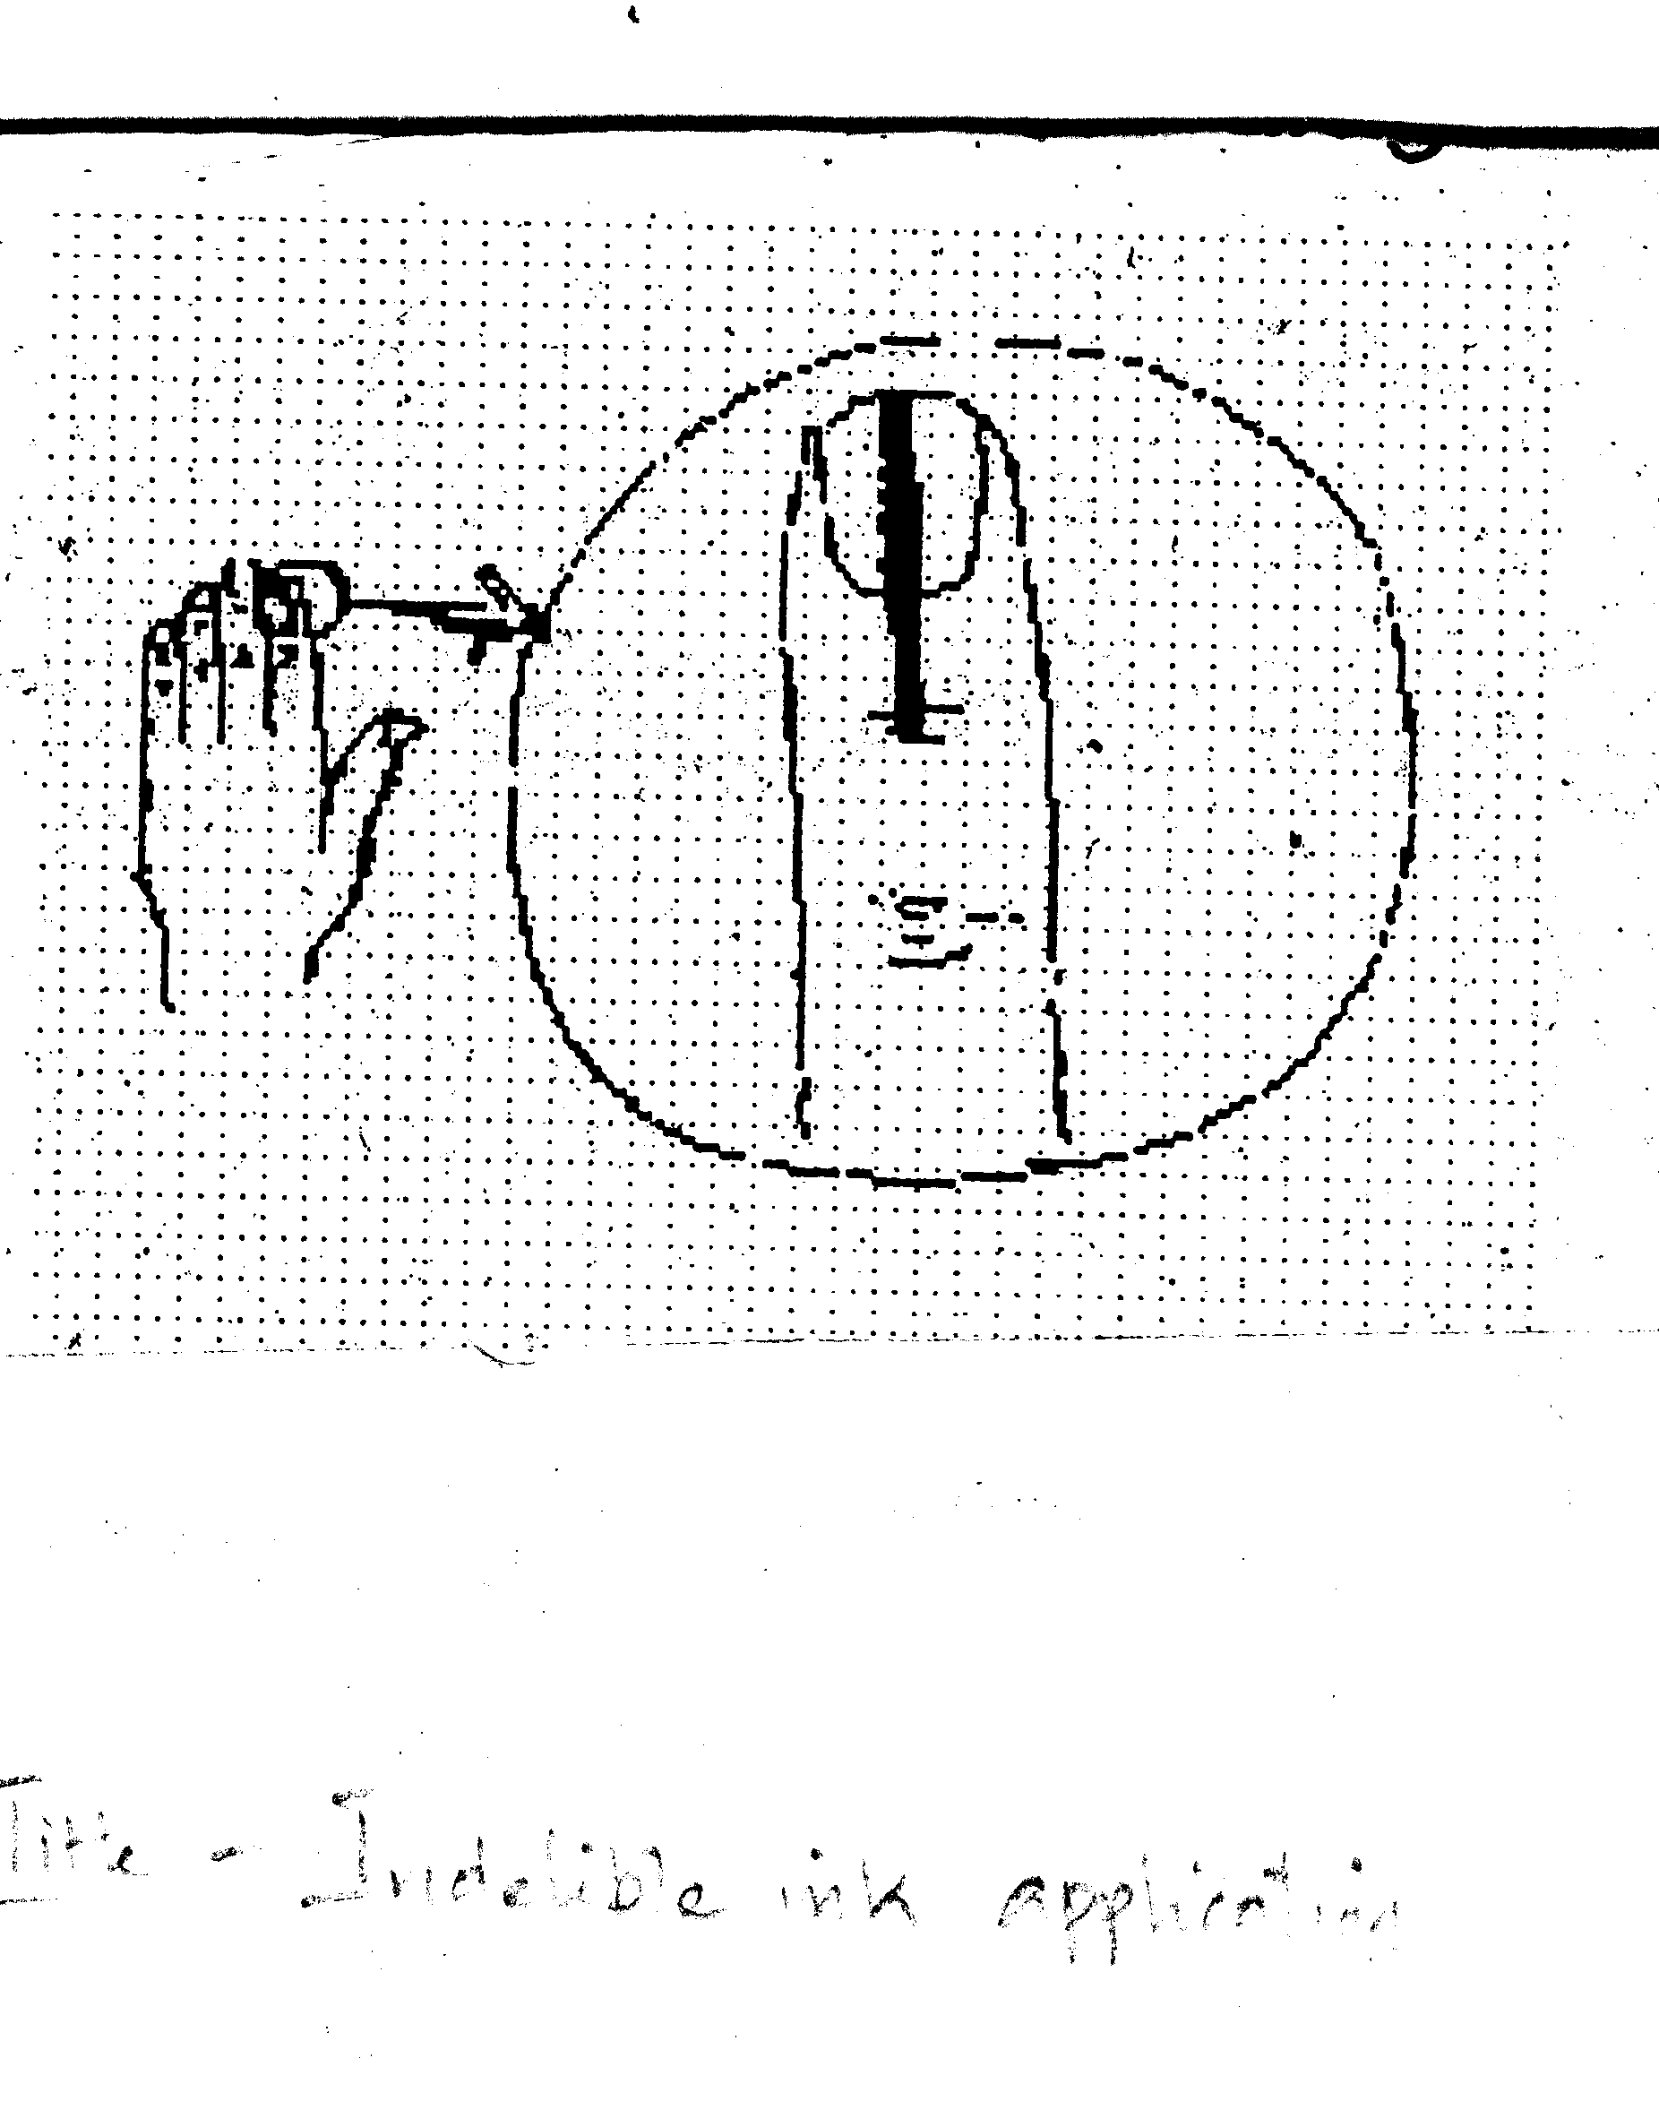
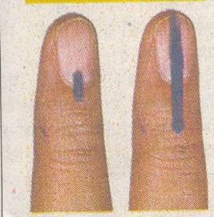
POLL DAY
Second Polling Officer
APPLICATION OF INDELIBLE INK
X
Old Marking New Marking

Slide 73
POLL DAY
Second Polling Officer
Precautions for indelible ink
Polling Officer in-charge to take adequate precautions regarding indelible kept carefully
Ink does not get tilted and the ink spilt during the poll.
Take some sand or loose earth or an empty tin or some broad-bottomed vessel, and push the phial down three-quarters of its length into the centre
Ensure the plastic rod attached to the cork is left/kept standing and not taken out except for marking the voter’s forefinger.
The rod should always be held with its marking end pointing vertically downwards.

Slide 74
POLL DAY
Second Polling Officer
FINER POINTS OF APPLICATION OF INDELIBLE INK
After identity of elector is verified by the 1st Polling Officer, the 2nd Polling Officer to inspect of the left hand forefinger.
If no mark is seen, apply indelible ink – a line from the top end of the nail to the bottom of the first joint.
If the elector refuses to allow his left forefinger to be inspected or marked as per instruction, has the mark already or does any act to remove the ink, do not allow him to vote.

Slide 75
POLL DAY
Second Polling Officer
FINER POINTS OF APPLICATION OF INDELIBLE INK
If he has no left hand forefinger, apply indelible ink on any finger of left hand.
If no finger on left hand, apply ink on his right hand forefinger.
If no right hand forefinger, on any finger of right hand starting with his forefinger.
If he has no finger on either hand – apply on such stump of his left or right hand.

Slide 76
POLL DAY
Second Polling Officer
APPLICATION OF INDELIBLE INK FOR COMPANION
Indelible ink shall be applied on the right index finger of the COMPANION also.
A person cannot act as a companion of more than one elector.

Slide 77
POLL DAY
Second Polling Officer
ENTRIES IN REGISTER OF VOTERS (Form 17-A)
After applying indelible ink get signature/thumb impression in the register.
In col.2 write the Sl. No. of the elector in electoral roll (like 191, 709).
In col. 3, write details of the documents produced by the elector for proof of identification.
Just mention “EP” for EPIC .
The number of EPIC need not be mentioned.

Slide 78
POLL DAY
Second Polling Officer
ENTRIES IN REGISTER OF VOTERS (Form 17-A)
If other documents are prescribed for identity of voters, mention the document in col.3 and note down the last four digits in col. 3 itself.
Get his full signature/clear thumb impression (neither faint nor smudged) in col.4.
An elector having a left thumb shall not be allowed to put any other finger mark.

Slide 79
POLL DAY
Second Polling Officer
ENTRIES IN REGISTER OF VOTERS (Form 17-A)
Putting a mark cannot be taken as signature.
If the elector refuses to sign in full, his thumb impression should be taken.
If refuses to affix thumb impression also, do not allow him to vote (49 M).
Thumb impression need not be attested.
In case of infirm voter, who cannot use either of hands, signature/thumb impression of the companion can be taken. Make a note to this effect.

Slide 80
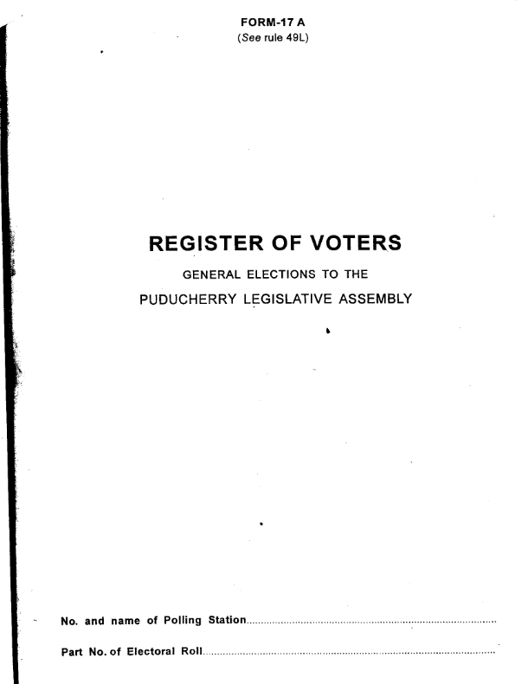
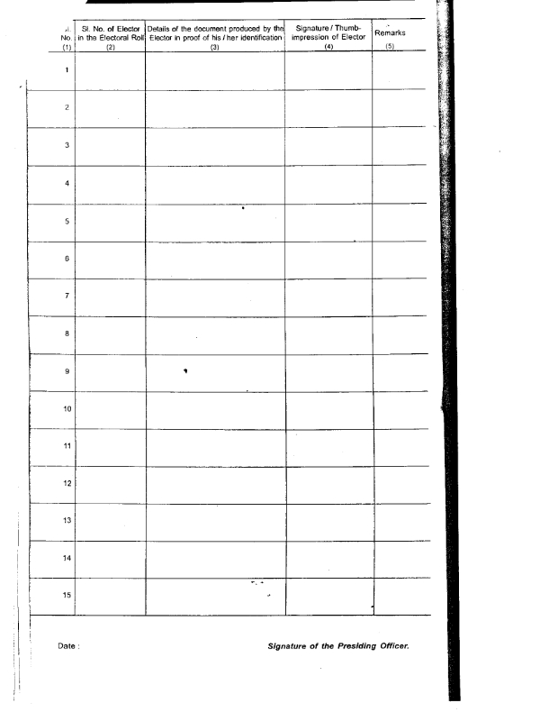
POLL DAY
Second Polling Officer
ENTRIES IN REGISTER OF VOTERS (Form 17-A)

Slide 81
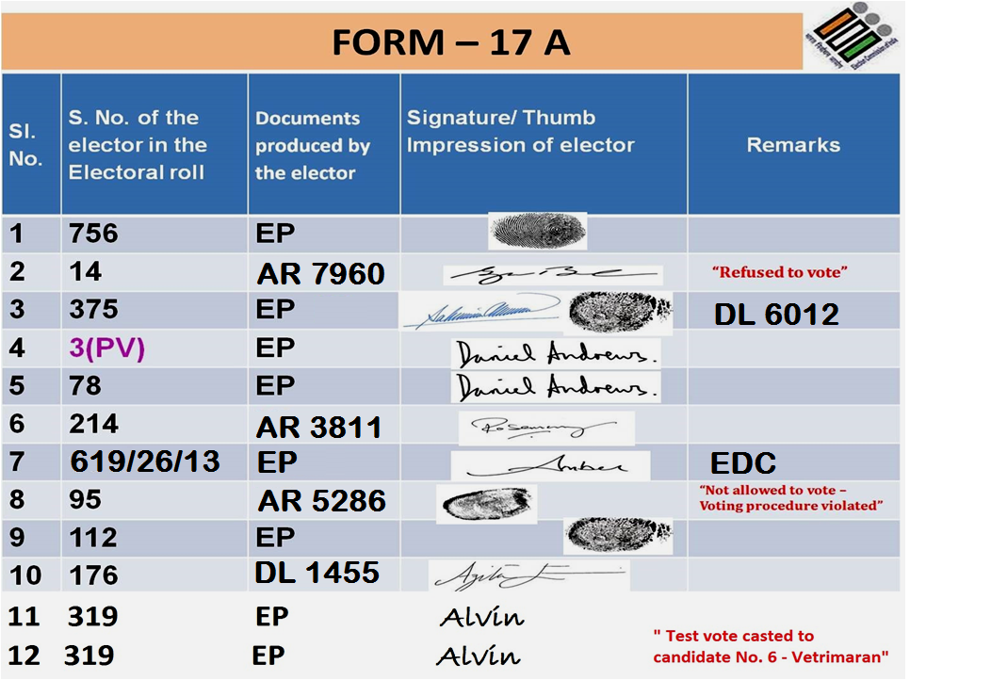
POLL DAY
Second Polling Officer
ENTRIES IN REGISTER OF VOTERS (Form 17-A)

Slide 82
POLL DAY
Second Polling Officer
ENTRIES IN REGISTER OF VOTERS (Form 17-A)
Sl. No. | Sl. No. of elector in the marked copy of the electoral roll | Identification document used | Signature/ Thumb impression | Remarks
10. | 348 | EP | Sd.

Slide 83
POLL DAY
Second Polling Officer
ISSUE OF VOTER SLIP
2nd Polling Officer shall fill up the printed voters slip containing the following:
Sl. No. of elector (as per col.1 of the register of voters – 17A Register)
Sl. No. of the elector (as entered in the electoral roll)
Initials of Polling Officer.
With the voter’s slip, the elector is to go to the 3rd Polling Officer who will be in-charge of control unit.

Slide 84
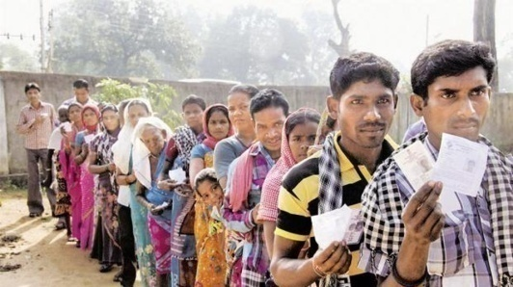

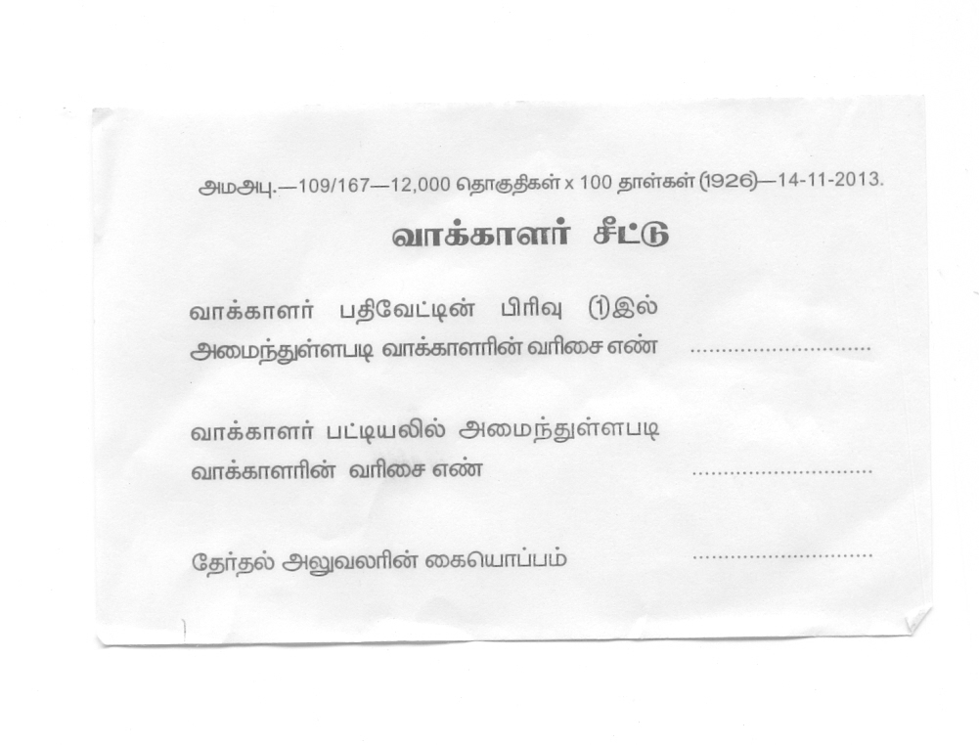
POLL DAY
VOTER’S SLIP
11
568
Karthik

Slide 85
DUTIES AND RESPONSIBILITIES OF 3RD POLLING OFFICERS

Slide 86
POLL DAY
Third Polling Officer
INCHARGE OF CONTROL UNIT
Responsible for the operation of control unit;
Allow the elector to vote on the receipt of voter’s slip and in accordance with serial number indicated in the slip;
To ensure that the elector’s left hand forefinger bears a clear indelible ink mark.
For every 50 voter slip received, bundle the same and confirm the total votes polled at regular interval with 17A and Polling Officer I.

Slide 87
POLL DAY
Third Polling Officer
Permitting elector to vote
After elector comes with the voter's slip, the Third polling officer will take the voter's slip from him, check his finger for ink and allow him to vote.
All voter’s slips will be preserved and kept after sealing in a separate cover .

Slide 88
POLL DAY
Third Polling Officer
VOTING PROCESS
3rd Polling Officer to activate the ballot unit – Press BALLOT button in control unit.
BUSY lamp shows RED in control unit.
READY lamp glows GREEN in ballot unit.
Elector to press BLUE button on the ballot unit against the name and symbol of his chosen candidate.
After beep sound, red light in the candidate’s lamp indicate the vote is recorded.

Slide 89
POLL DAY
Third Polling Officer
VOTING PROCESS
In the VVPAT a slip containing the Sl. No., name and symbol of the candidate to whom vote was cast will be displayed for seven seconds .
Beep sound can also be heard.
The slip will automatically drop into the drop box after seven seconds.
NOTE : The Vote will be counted in CU only after the drop of the VVPAT Slip

Slide 90
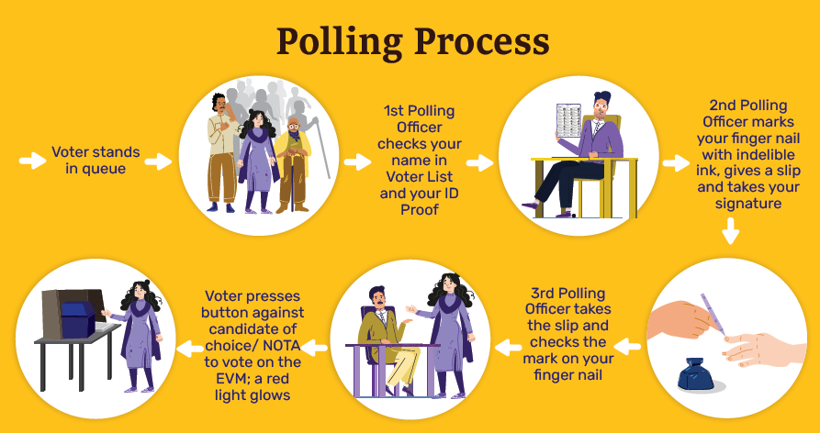
POLL DAY
SNAPSHOT OF DUTIES OF POLLING OFFICE 1, 2 & 3

Slide 91
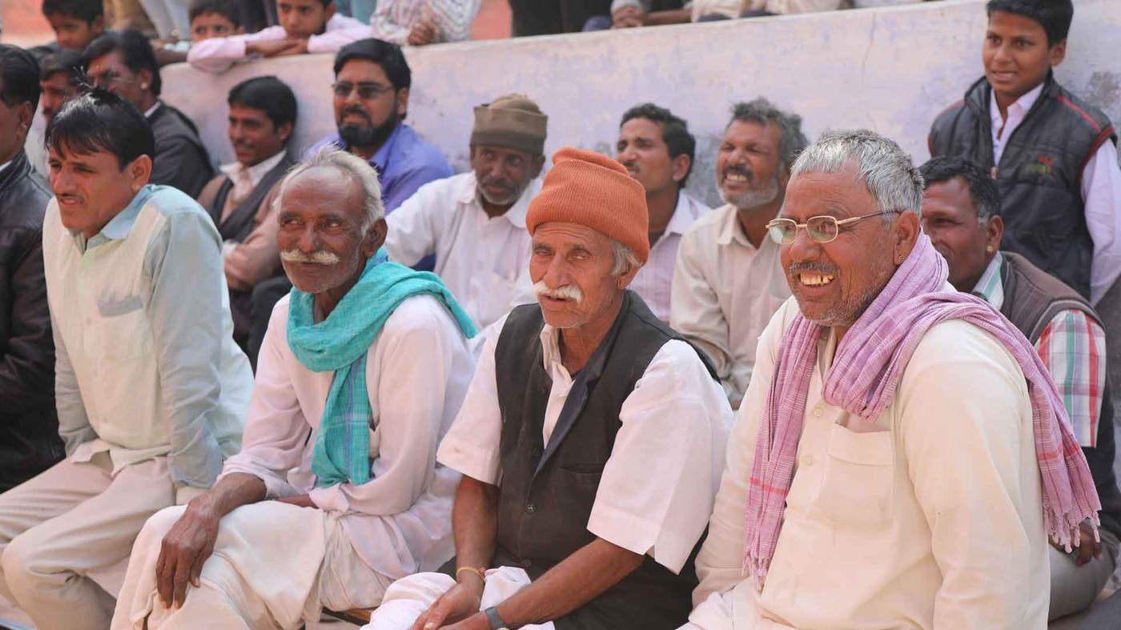
POLL DAY
POLLING AGENTS

Slide 92
POLL DAY
POLLING AGENTS
Polling agents to be electors with EPIC/ Doc of same/adjoining Polling Station/Same AC
Person provided with security cannot be a Polling Agent.
The Presiding Officer has to check their appointment letters and issue Polling Agent passes – maintain account for entry passes to Polling Agents.

Slide 93
POLL DAY
POLLING AGENTS
Polling Agents to reach the Polling Station at least 90 minutes before start of poll.
For late comer, no action replay.
If he comes late, permit him to participate in further proceedings.
Polling agent/Relieving agent movement sheet is to be maintained. Annex 11 P.No: 124

Slide 94
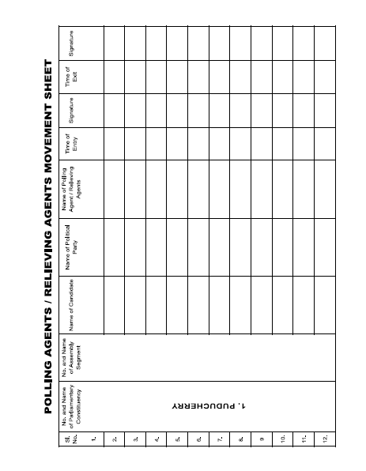
POLL DAY
POLLING AGENTS

Slide 95
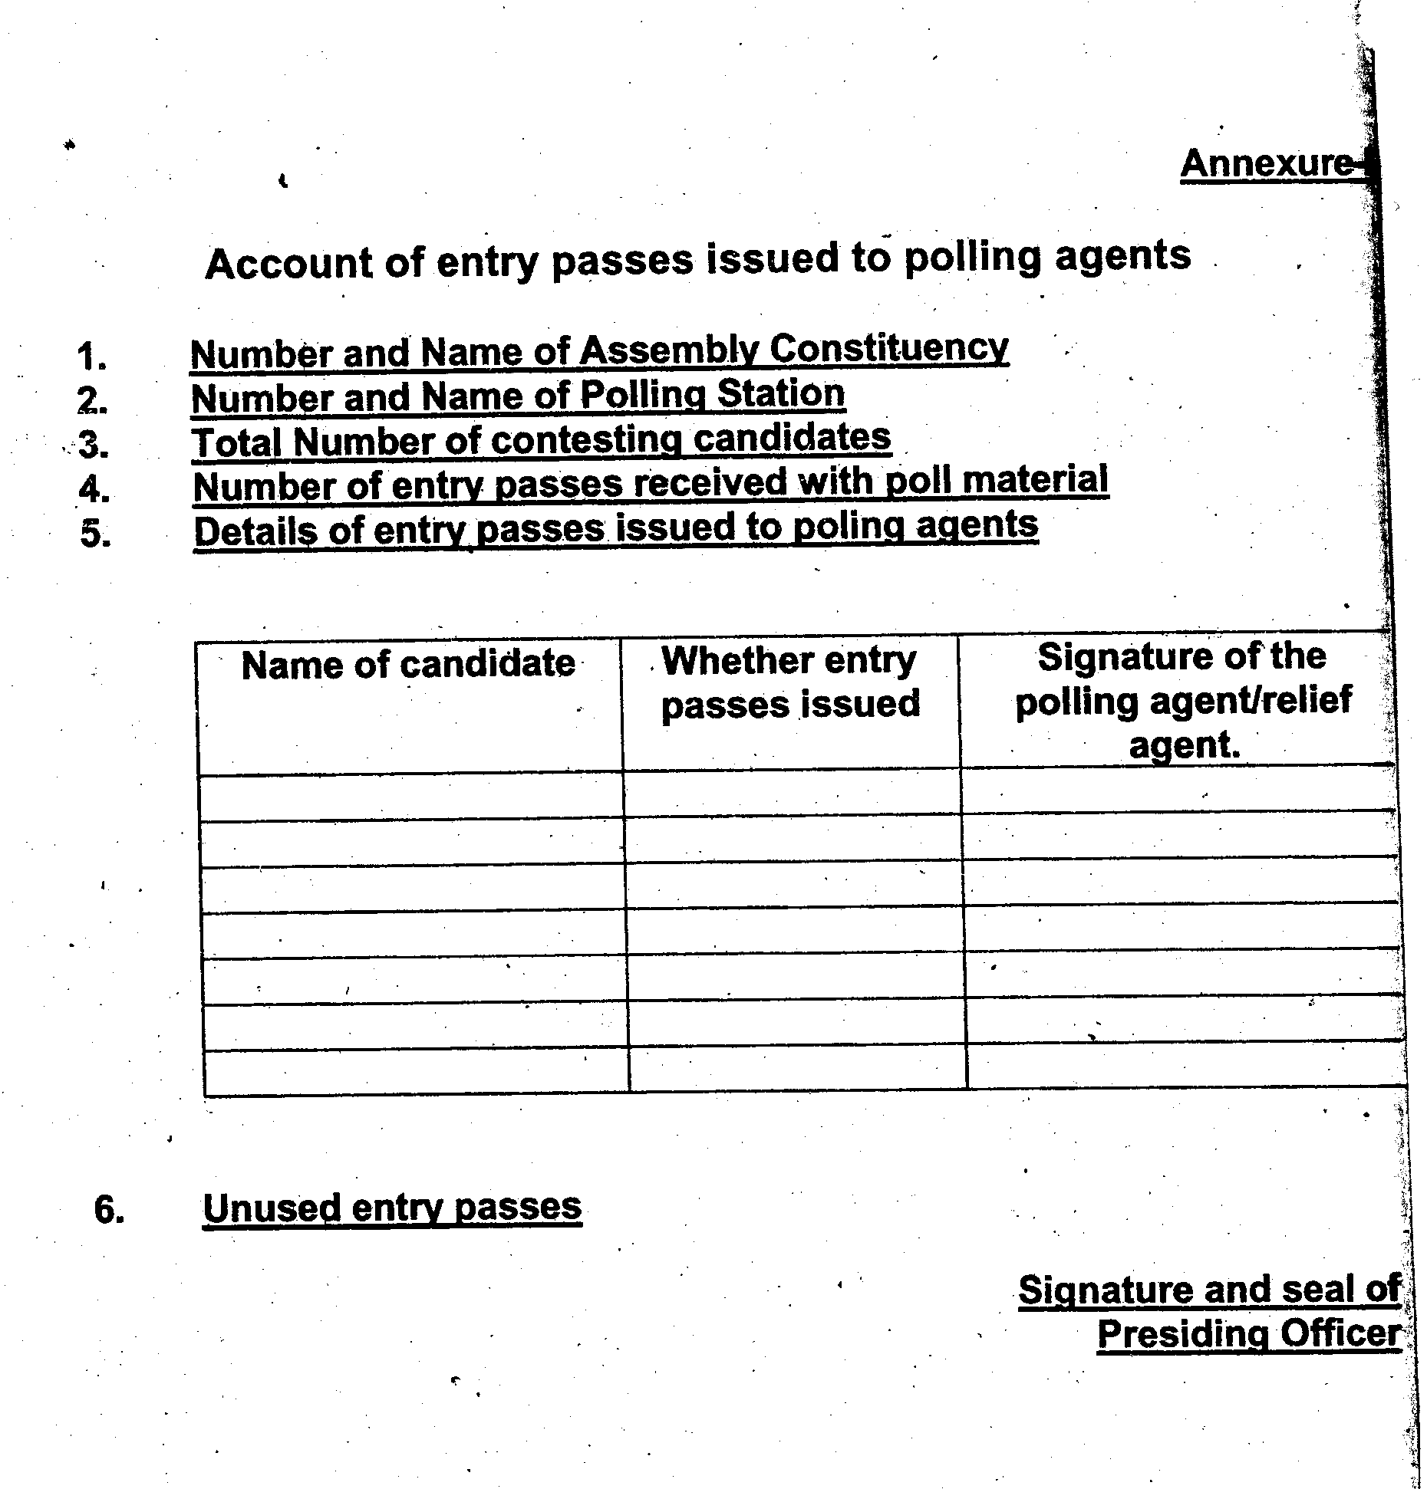
POLL DAY
POLLING AGENTS

Slide 96
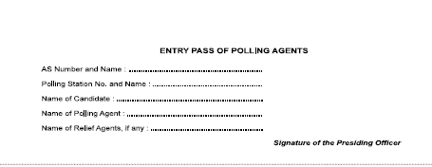
POLL DAY
POLLING AGENTS

Slide 97
POLL DAY
POLLING AGENTS
Polling Agents not to take electoral roll copy outside the Polling Station till the polling is closed.
Polling Agents not to be allowed to send slips outside indicating the Sl. Nos. of the voters who voted or not voted.
Even after 3 P.M. may be allowed to go out or leave the Polling Station and come inside.
Polling Agents not to carry cell phone, cordless phone, wireless sets inside the Polling Station.
Polling Agents to display EPIC and entry pass.

Slide 98
POLL DAY
POLLING AGENTS
POLLING AGENTS – SEATING ORDER AT POLLING STATION
Candidates of
Recognized national parties;
Recognized state parties;
Recognized state parties of other States permitted to use their reserved symbols;
Registered unrecognized parties;
Independent Candidates.

Slide 99
PHOTOGRAPHY/VIDEOGRAPHY
POLL DAY
Only ECI authorized media persons to be allowed inside the Polling Station.
Extra care to be taken when a VIP votes.
Secrecy of voting should be ensured.
Photo / Videography of crowd of electors outside the Polling Station may be permitted.

Slide 100
PERSONS AUTHORIZED TO ENTER THE POLLING STATION
POLL DAY
Electors assigned to the Polling Station.
Polling Officers.
Candidates, his election & polling agents.
Persons authorized by the Commission – media and Micro Observer – Verify the authority letters issued to media.
Public servants on duty.
RO/ARO/Observers.

Slide 101
PERSONS AUTHORIZED TO ENTER THE POLLING STATION
POLL DAY
A child in arm accompanying an elector.
Person accompanying a blind/infirm voter.
Person employed to identify voters.
In case of elector/candidate with Z+ security, one security personnel in civil clothes with concealed small arm can accompany the secured person.
Every one to have a valid photo identity properly displayed.

Slide 102
PERSONS AUTHORIZED TO ENTER THE POLLING STATION
POLL DAY
Police officers are not permitted inside the Polling Station except as voters.
Police may be called inside the booth if need arises – to maintain law and order.
Security personnel accompanying an elector/candidate should not be allowed inside the Polling Station.
Ministers are not public servants on duty.
Security personnel accompanying Ministers are not allowed inside the Polling Station.
VAO/woman attendant to be allowed only when identification is required.

Slide 103
SPECIAL CASES

Slide 104
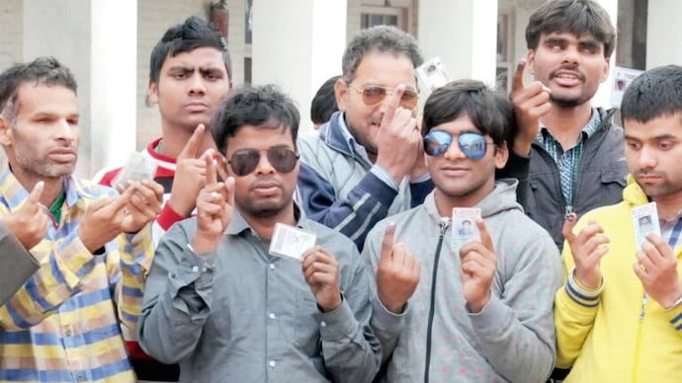
POLL DAY
VOTING BY BLIND & INFIRM VOTERS

Slide 105
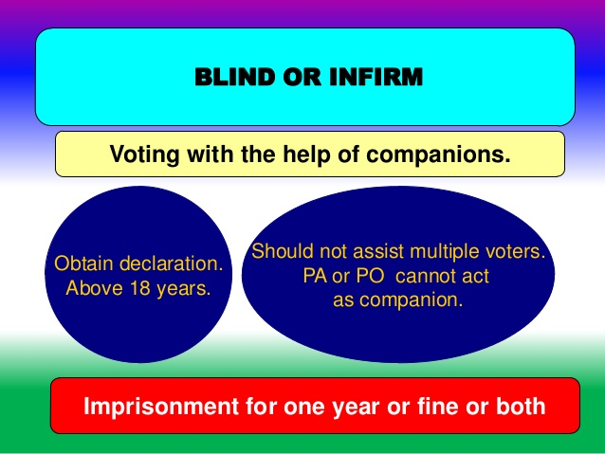
POLL DAY - 49 N

Slide 106
CASE OF DIFFERENTLY-ABLED VOTERS
POLL DAY
Thumb impression on the register of voters by blind or infirm or leper electors, who are illiterate but can use their hand.
Literate person should be allowed to put signature by writing name.
In case of infirm voters, who cannot use either of their hands, the companion should sign or put thumb impression .
A note may be made against each such entry.
POLL DAY – 09.04.2026

Slide 107
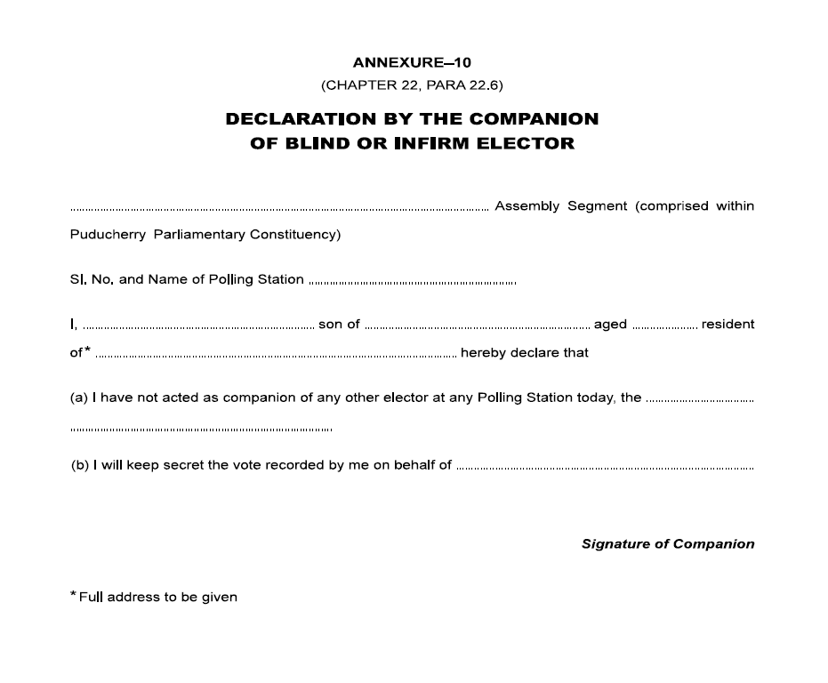

Slide 108
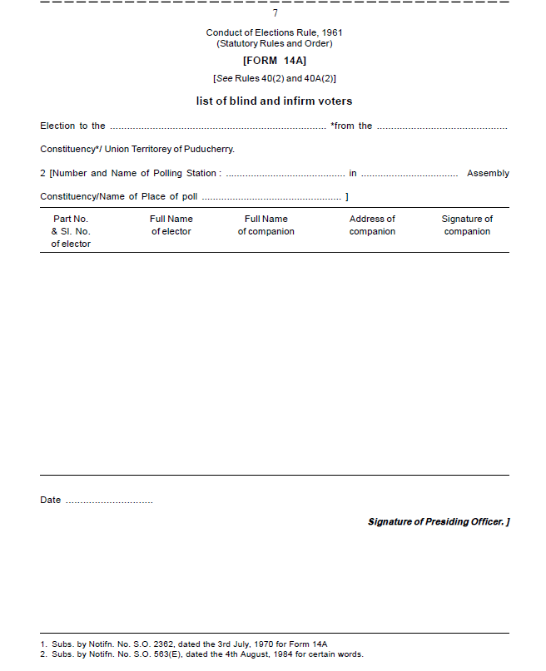

Slide 109

POLL DAY - 49 M
REFUSAL TO OBSERVE POLL PROCEDURE

Slide 110

POLL DAY – 49 M
ELECTOR NOT ALLOWED TO VOTE

Slide 111



POLL DAY – 49 M
A voter violating the voting procedure or secrecy of voting shall not be allowed to vote

Slide 112
POLL DAY – 49 M
MAINTENANCE OF SECRECY
Every elector should maintain absolute secrecy in voting.
If he refuses to do, warn him.
If voter’s slip has been issued to him, withdraw and cancel it.
Mark ‘Not allowed to vote – Voting procedure violated – 49 M’ in the remarks column in the Register of Voters and sign there.
Take care of such entries while noting the number of votes polled and filling up Form 17 C at the end of the poll.

Slide 113

POLL DAY – 49 O
VOTER DECIDED NOT TO VOTE

Slide 114
POLL DAY – 49 O
ELECTOR REFUSE TO VOTE
If ballot button has been pressed already, allow the next voter to vote.
If the last elector refuses to vote, switch off the power switch of the Control Unit (rear compartment) and disconnect the VVPAT from the Control Unit.
Switch on the power switch, after busy lamp goes off, press CLOSE button.
Remember : RESULT button will function (while counting) only if CLOSE button is pressed.
ELECTOR DECIDING NOT TO VOTE

Slide 115
POLL DAY – SERVICE VOTERS
Some categories of service voters have been given the facility of voting through proxy appointed by them.
Such voters are categorized as “Classified Service Voters” (CSVs).
The Returning Officer will supply list of the CSVs
This list of CSVs is to be treated as part of the marked copy of the electoral roll for your polling station
VOTING BY PROXY - CSV

Slide 116

POLL DAY - CSV

Slide 117

POLL DAY – 49 P

Slide 118

Tendered Votes –List in Form 17 B
POLL DAY – 49 P

Slide 119

POLL DAY
POLL DAY – SPECIAL CASES
CHALLENGING IDENTITY OF VOTER

Slide 120

POLL DAY

Slide 121

CHALLENGE FEE - RECEIPT
POLL DAY – SPECIAL CASES

Slide 122

POLL DAY – SPECIAL CASES

Slide 123

POLL DAY – SPECIAL CASES

Slide 124
TEST VOTE
POLL DAY – 49 MA
ALLEGATION BY THE VOTER :- Paper slip generated by the VVPAT has shown the name or symbol of a candidate other than the one he voted for.
WARN :- Warn the elector about the consequence of making false declaration.
Presiding Officer shall make a second entry related to that elector
Permit the elector to record a test vote in the voting machine in his presence and in the presence of the candidates or Polling Agents who may be present in the Polling Station and observe the paper slip generated by the VVPAT in Form 17A

Slide 125
Test Vote – Consequences
POLL DAY – 49 MA
TRUE / FALSE
TRUE:- Presiding Officer shall report the facts immediately to the Returning Officer, stop further recording of votes in that voting machine and act as per the direction that may be given by the Returning Officer
FALSE :- Presiding Officer shall make a remark to that effect against the second entry relating to that elector in Form 17A mentioning the serial number and name of the candidate for whom such test vote has been recorded and obtain the signature or thumb impression of that elector against such remarks and make necessary entries regarding such test vote in item 5 in part I of Form 17C.
HAND OVER TO POLICE

Slide 126

POLL DAY – 49 MA

Slide 127

POLL DAY – SPECIAL CASES

Slide 128

POLL DAY – SPECIAL CASES
Obtain
declaration
If he refuses to give a declaration, do not allow him to vote.

Slide 129

POLL DAY – SPECIAL CASES

Slide 130

POLL DAY – SPECIAL CASES

Slide 131

POLL DAY – SPECIAL CASES

Slide 132

POLL DAY – SPECIAL CASES

Slide 133
POLL DAY – SPECIAL CASES
SUPERVISORY VISITS
Observers/CEO/JCEO/RO/ARO;
Sector Officers;
Candidates;
Candidate’s Election Agents;
All of them must record their visit and observations in the visit sheet.

Slide 134

POLL DAY – VISIT SHEET

Slide 135

POLL CLOSING

Slide 136

POLL CLOSING
15

Slide 137
POLL CLOSING
CLOSE OF POLL
If the voters are in the queue at appointed hour of close of poll, issue tokens with pre-printed Sl. No. from the tail end.
Depute police to ensure that no one joins the queue after the appointed hour.
Poll shall continue till the last person with the token records his vote.
The Presiding Officer shall declare the poll closed.

Slide 138

POLL CLOSING
Serial numbered Pre Printed Slips

Slide 139
POLL CLOSING
Press CLOSE button on close of Poll and fill up Declaration in Part-III
Fill up the Part – III of Presiding Officer’s Report
Note Down Date & Time in the Presiding Officer’s Diary
Press TOTAL of CU to know the total votes recorded in the day
First Switch OFF the CU, Keep Paper Roll Knob of VVPAT horizontally
Remove Battery of VVPAT ( Not of CU)
Disconnect the cables carefully from among Units
Seal BU, CU & VVPAT in respective carrying cases and fix address tags having signatures of himself and Polling Agents

Slide 140


POLL CLOSING

Slide 141

POLL CLOSING

Slide 142
POLL CLOSING
CLOSING THE CONTROL UNIT
Note the number of votes in Form 17C.
Once CLOSE button is pressed no further votes will be accepted by the machine.

Slide 143

POLL CLOSING
CLOSING FORM 17-A AT THE END OF THE POLL
Draw a line at the end of the poll after the last entry in Form 17A and record the following signed statement:
“The serial number of the last entry in Form 17A is ---------------”
Obtain signature of all the Polling Agents below the statement.
Presiding Officer is to sign.

Slide 144


POLL CLOSING
FORM 17C – ACCOUNTS OF VOTES RECORDED

Slide 145
POLL CLOSING
FORM 17C – ACCOUNTS OF VOTES RECORDED
Utmost important report to be submitted by Presiding Officer
Sufficient number of copies to be prepared by using carbon paper
Two copes to be submitted to Returning Officer
One copy to be submitted to Sector Officer
One copy to be given to Polling Agent
One copy for presiding Officer for reference

Slide 146
Hands-on Task : Fill form 17-C with the following data
S.NO | DATA
1 | Union territory | Puducherry
2 | Constituency | Manavely
3 | Polling Booth number & address | 20/13 Govt Primary School, Edaiarpalayam
4 | Control unit number | CU1234
5 | Ballot unit number | BU1234
6 | VVPAT | VV10112
7 | Total number of electors assigned | 945
8 | Total number of electors recorded in 17-A | 762
9 | Number of electors decided not to vote (49-O) | 05
10 | Number of electors not allowed to vote (49-M) | 05
11 | Test votes | 02
12 | Candidates for whom test votes cast | xyz-01 vote Abc-01 vote
13 | Total number of votes recorded by voting machine | ??????

Slide 147

Puducherry
Manavely
20/13, Govt Primary School, Edaiarpalayam
CU1234
BU1234
VV10112
945
762
05
05
02
02
165,476
02
abc
01
11
xyz
01
752

Slide 148

Yes, Tallied
01
20
101 to 120
01
101
19
102 to 120
Jagan
04
Arun
300
304
01
Ramesh
03
Srinivassin
301
304
nil
Shankar
09-04-2026
Manavely
Udhayakumar.c
20/13

Slide 149
FILLING UP THE ENVELOPES

Slide 150
DEPOSITION OF THE ELECTION PAPERS TO THE SECTOR OFFICER AT POLLING STATION
To avoid delay and inconvenience at collection centre, pack the covers and other materials in 6 separate large packets.
Even if a statement or record is Nil, Nil must be written
I. First Packet ( white colour) – containing
EVM papers must be superscribed as” EVM PAPERS COVER”
(a) Envelope containing account of votes recorded- Form 17C
(b)Envelope containing PRO Report I (Mock Poll Certificate),II&III.
(c) Black Colour Sealed envelope containing Printed VVPAT paper slips of Mock Poll.
Note: Above papers must be kept in UNSEALED WHITE COLOURED MASTER ENVELOPE (1/1) and kept in Polled EVM Strong Room.

Slide 151
II. The Second Packet WHITE colour
Superscribed as SCRUTINY COVER-
Unsealed envelope containing PO Diary
Sealed envelope containing the Register of voters 17A
Unsealed envelope containing Visit Sheet.
Unsealed envelope containing the list of blind and infirm electors in Form 14 A and Declarations of Companions.
Note: The above papers must be kept in UNSEALED WHITE COLOURED MASTER ENVELOPE(2/1) and PS wise Scrutiny Covers must be stored in a strong room other than polled EVM strong room.

Slide 152
III. Third Packet White Colour
Superscribed as “STATUTORY COVER”:-
Sealed envelope containing marked copy and list of CSVs
Sealed envelope containing Voter Slips
Sealed envelope containing Unused Tendered Ballot Papers
Sealed envelope containing used tendered ballot papers and the list in Form 17B
Sealed envelope containing challenged votes in Form 14.

Slide 153
IV . FOURTH PACKET- YELLOW COLOUR
super scribed as “NON-STATUTORY COVER”:-
Envelope containing Copies of electoral rolls other than marked copies,
Envelope containing Appointment letters of polling agents in Form 10
Envelope containing Election duty certificate in Form 12 B
Envelope containing Declarations by PRO
Envelope containing the receipt book & Cash, if any for challenged votes,
Envelope containing the declaration obtained from electors as to their age such electors who have refused to make declaration as to their age.
Envelope containing unused and damaged paper seals and spl.tags.
8) Envelope containing Unused voter slips

Slide 154
IV . FOURTH PACKET- YELLOW COLOUR (cont)
(super scribed as “NON-STATUTORY COVER”):-
9) Envelope containing Form of Declaration by electors under 49 MA (Test Vote).
Envelope containing Form of Declaration by elector whose name is in ASD List.
Envelope containing letter of complaint to SHO.

Slide 155
V.THE FIFTH PACKET Brown Colour
Handbook of Presiding Officers,
Manual of EVM and VVPAT, Instructions Etc…
Indelible Ink set
Used Stamp Pad (Brown Colour)

Slide 156

THE SIXTH PACKET Blue Colour
Candidate information booklet
Other unused forms
Metal Seal of the Presiding Officer
The Arrow cross mark rubber stamp for marking tendered ballot papers
Cup for setting the indelible ink
All other items

Slide 157
Sealing of Covers
Each of the 4 smaller covers in THIRD PACKET- Statutory Covers to be SEALED and the cover containing the list of Challenged Votes in Form 14 to be SEALED.
Envelope containing 17 A in the SECOND PACKET – Scrutiny Cover to be sealed.
All these covers must be simply placed in the respective bigger covers after tick marking at the top page of the bigger covers and signed.
These bigger packets need not be sealed but may be properly secured by means of pins or threads so that contents may be checked at the collection centre.
The Third Packet super scribed as Statutory Cover should however be sealed by the PRO after checking of the contents by the personnel at the collection centre

Slide 158
RECEPTION OF POLLING MATERIALS
Collection of Polled Materials from Polling Stations (After 6.00 PM)
Sector Officers shall visit Polling Stations one by one after the close of poll.
Sealed EVMs and all Statutory & Non-Statutory Forms shall be received from the Presiding Officers.
Detailed checking may be carried out at the Reception Centre in the presence of the Presiding Officer.

Slide 159
RECEPTION OF POLLING MATERIALS
Movement to Reception Centre
Only the Presiding Officer shall accompany the Sector Officer in the vehicle transporting EVMs and polled materials.
All other Polling Staff shall be relieved at the Polling Station after reception of polled materials.

Slide 160
RECEPTION OF POLLING MATERIALS
Relieving of Presiding Officers
After successful handing over of all EVMs and materials, Presiding Officers shall be permitted to leave the Reception Centre.

Slide 161
NOTE
This presentation is nutshell of the Poll process.
This is only to supplement and not substitute the Presiding Officer’s Hand Book.
Read the Hand Book thoroughly till you are conversant and comfortable.

Slide 162

ANY DOUBT

Slide 163


Slide 164
Wishing you all to have a happy and memorable election duty experiences…
Thank you

Slide 165

Thank
You

